Slide 1
Web Database Programming
Dr. Abu Sayed Md. Mostafizur Rahaman
Professor
Department of Computer Science and Engineering
Jahangirnagar University

Slide 2
References
Internet and World Wide Web How To Program (5th Edition) 5th Edition
by Harvey & Paul) Deitel & Associates, Harvey Deitel, Abbey Deitel
Web Programming Step by Step
by Marty Stepp, Jessica Miller, and Victoria Kirst
https://www.w3schools.com/
Pro Spring Boot by Gutierrez, Felipe
Mastering Spring Boot 2.0 by by Dinesh Rajput
Spring Microservices in Action by John Carnell
Spring Boot in Action by Craig Walls

Slide 3
Chapter 2 Introduction to HTML5
Internet & World Wide Web How to Program, 5/e

Slide 4
Topics
Introduction
Editing HTML5
First HTML Example
W3C HTML Validation Service
Heading
Linking
Images
Special Charecters
List

Slide 5
2.1 Introduction
HTML5 (HyperText Markup Language 5)
markup language that specifies
the structure and
content of documents that are displayed in web browsers
We introduce some basics, then cover more sophisticated HTML5 techniques such as:
tables, which are particularly useful for structuring information from databases (i.e., software that stores structured sets of data)
forms for collecting information from web-page visitors
internal linking for easier page navigation
meta elements for specifying information about a document

Slide 6
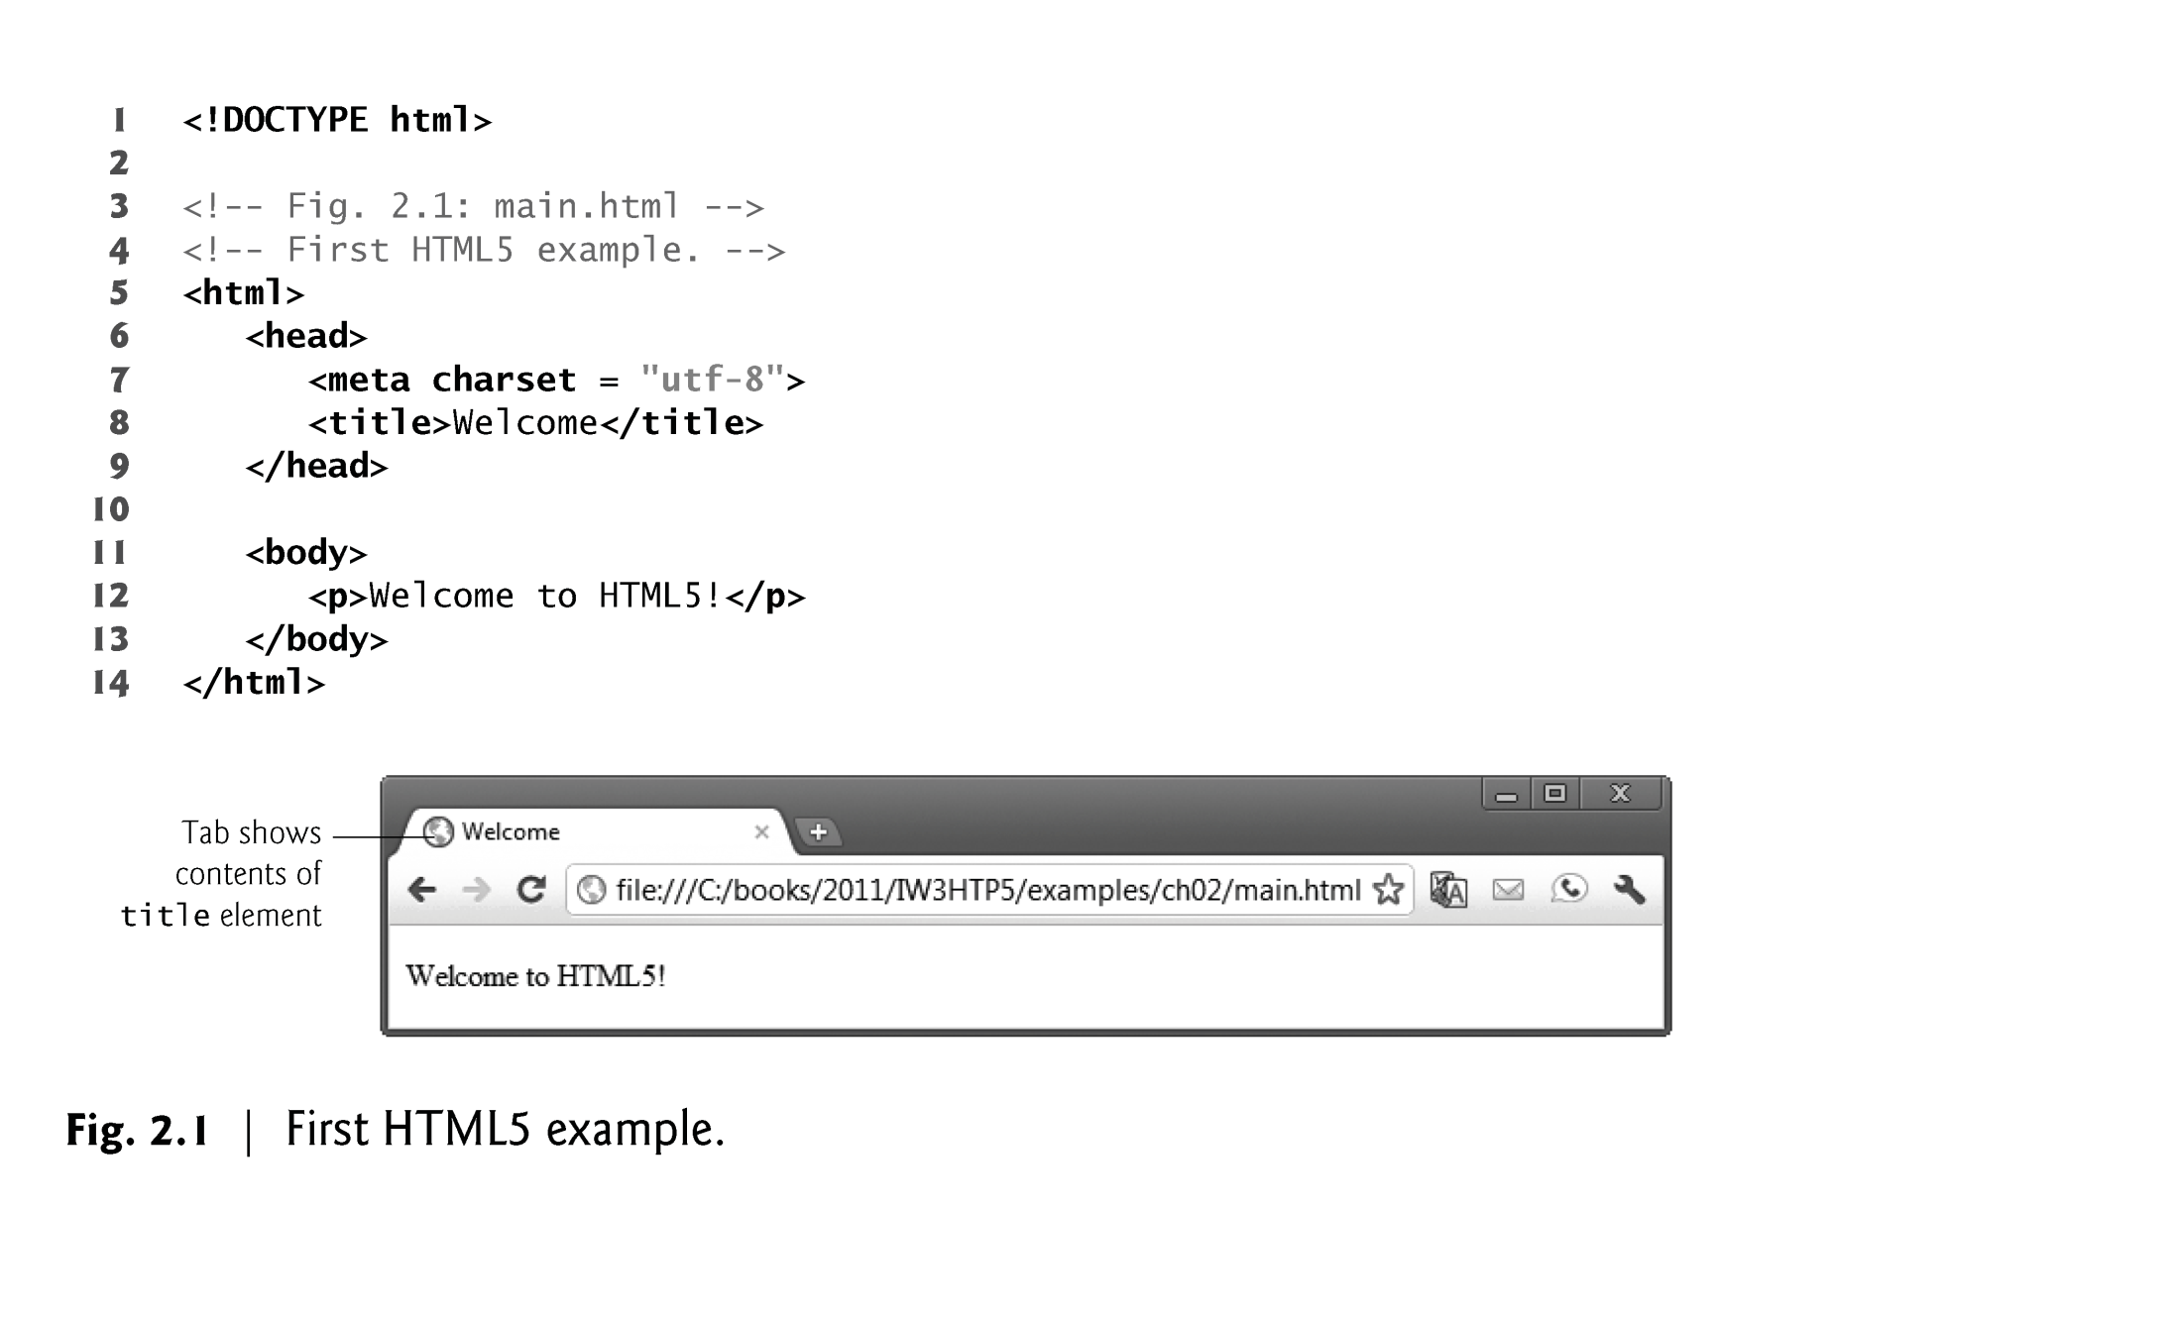
2.3 First HTML5 Example

Slide 7
2.3 First HTML5 Example
Document Type Declaration
The document type declaration (DOCTYPE) is required in HTML5 documents so that browsers render the page in standards mode.

Slide 8
2.3 First HTML5 Example
Comments
Insert comments in your HTML5 markup to improve readability and describe the content of a document.
The browser ignores comments when your document is rendered.
Comments start with <!-- and end with -->.

Slide 9
2.3 First HTML5 Example
html, head and body Elements
HTML5 markup contains text (and images, graphics, animations, audios and videos) that represents the content of a document and elements that specify a document’s structure and meaning.
The html element encloses the head section (represented by the head element) and the body section (represented by the body element).
The head section contains information about the HTML5 document, such as the character set (UTF-8, the most popular character-encoding scheme for the web) that the page use—which helps the browser determine how to render the content—and the title.
The head section also can contain special document-formatting instructions called CSS3 style sheets and client-side programs called scripts for creating dynamic web pages.
The body section contains the page’s content, which the browser displays when the user visits the web page.

Slide 10
2.3 First HTML5 Example (cont.)
Start Tags and End Tags
HTML5 documents delimit most elements with a start tag and end tag.
A start tag consists of the element name in angle brackets
For example, <html>
An end tag consists of the element name preceded by a forward slash (/) in angle brackets
For example, </html>
There are several so-called “void elements” that do not have end tags.
Many start tags have attributes that provide additional information about an element, which browsers use to determine how to process the element.
Each attribute has a name and a value separated by an equals sign (=).

Slide 11
2.3 First HTML5 Example (Cont.)
Title Element
The title element is called a nested element, because it’s enclosed in the head element’s start and end tags.
The head element is also a nested element, because it’s enclosed in the html element’s start and end tags.
The title element describes the web page.
Titles usually appear in the title bar at the top of the browser window, in the browser tab on which the page is displayed, and also as the text identifying a page when users add the page to their list of Favorites or Bookmarks, enabling them to return to their favorite sites.
Search engines use the title for indexing purposes and when displaying results

Slide 12
2.3 First HTML5 Example (Cont.)
Paragraph Element (<p>...</p>)
All text placed between the <p> and </p> tags forms one paragraph.

Slide 13
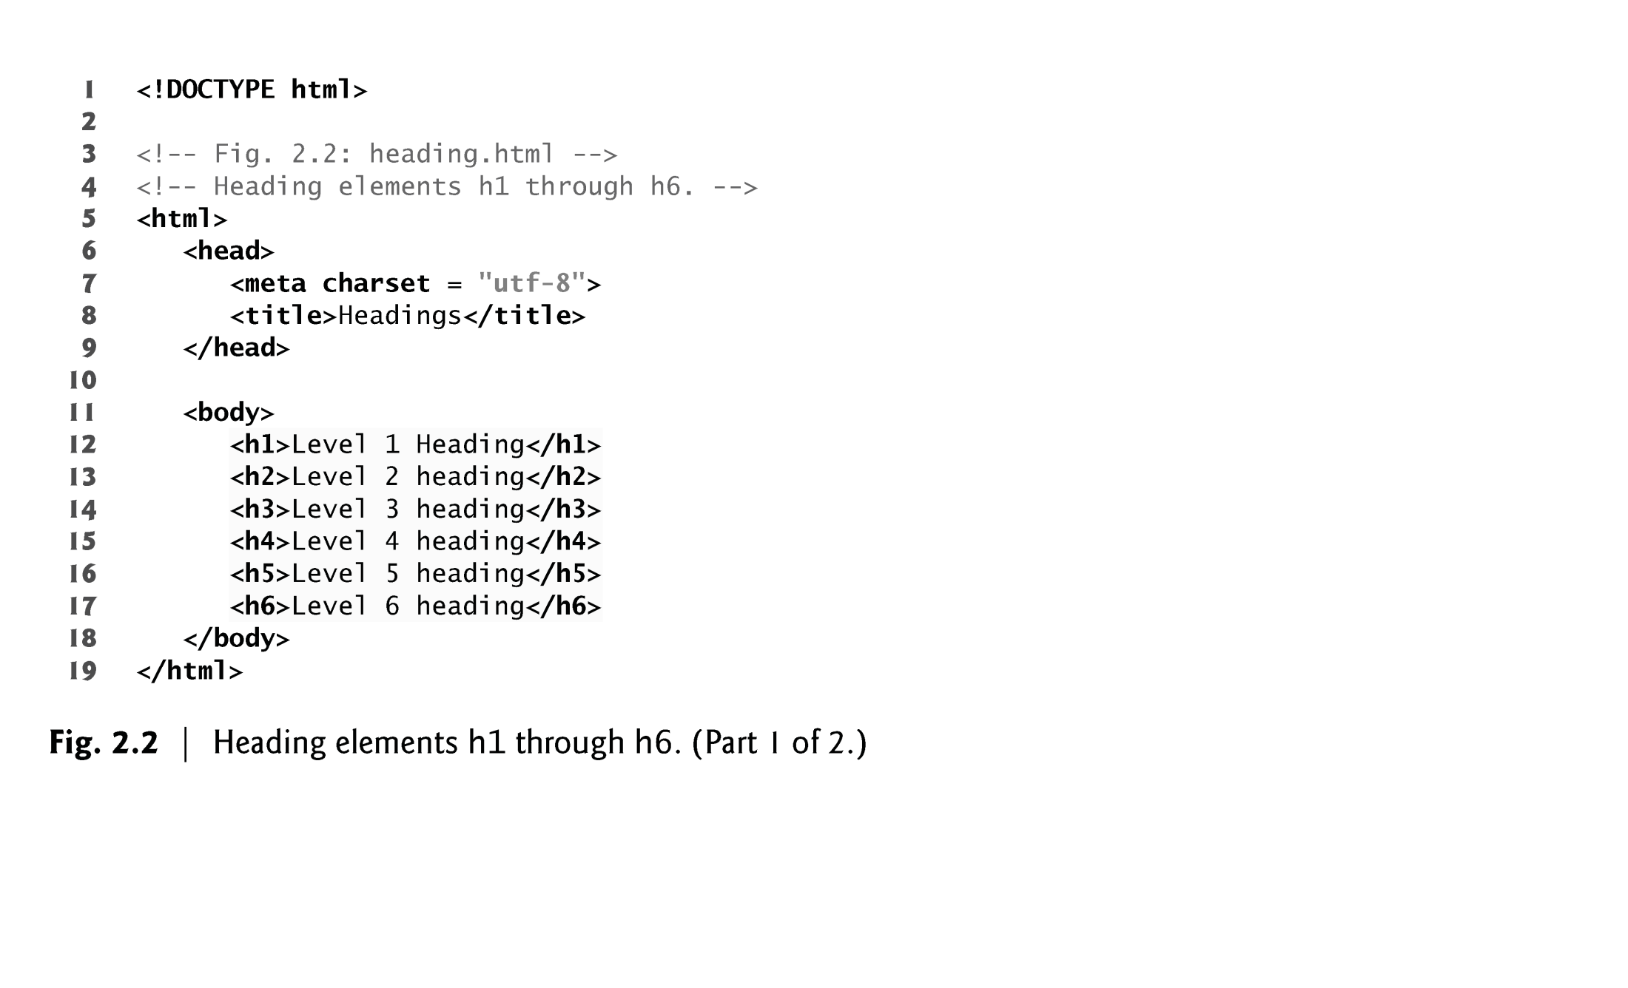
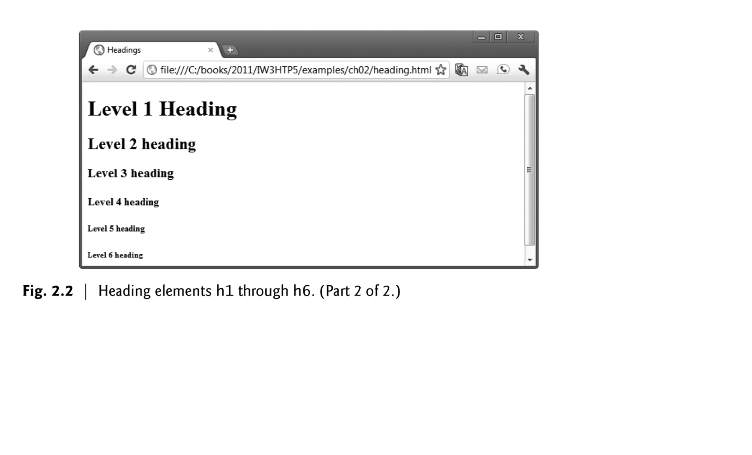
2.5 Headings
HTML5 provides six heading elements (h1 through h6) for specifying the relative importance of information
Heading element h1 is considered the most significant heading and is rendered in the largest font.
Each successive heading element (i.e., h2, h3, etc.) is rendered in a progressively smaller font.

Slide 14
2.6 Linking
A hyperlink references or links to other resources, such as HTML5 documents and images.
Web browsers typically underline text hyperlinks and color them blue by default.

Slide 15
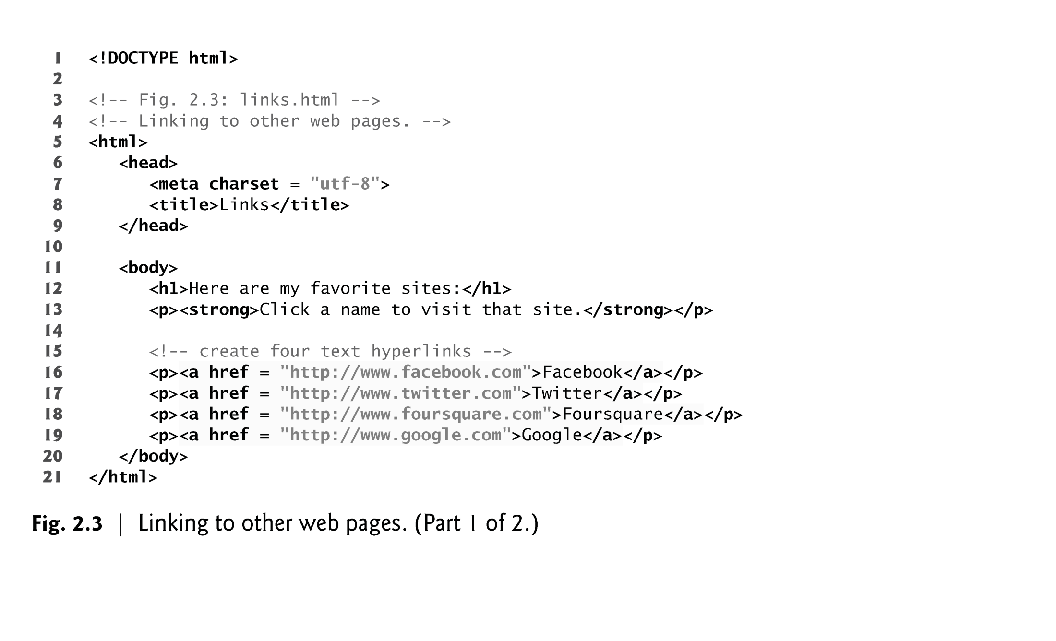
2.6 Linking
A hyperlink references or links to other resources, such as HTML5 documents and images.
Web browsers typically underline text hyperlinks and color them blue by default.

Slide 16
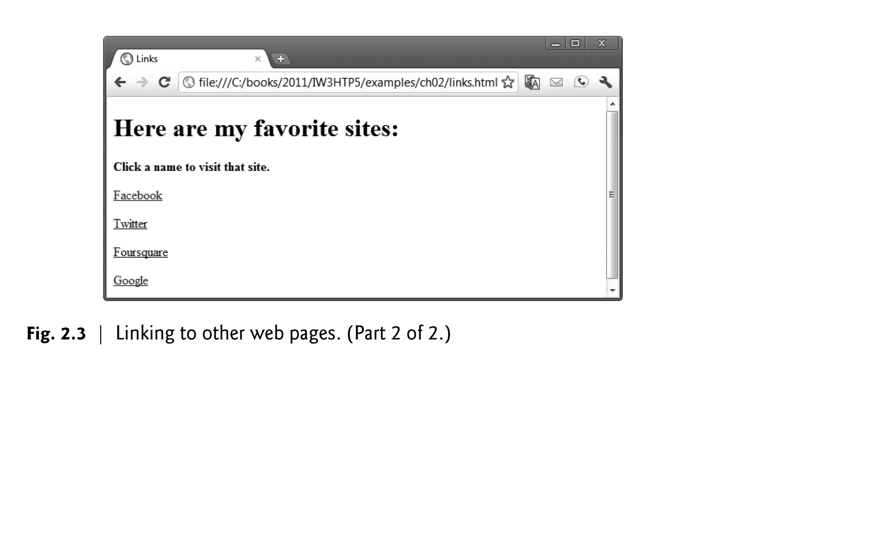
EXAMPLE-Output

Slide 17
2.6 Linking (Cont.)
The strong element indicates that the content has high importance. Browsers typically render such text in a bold font.
Links are created using the a (anchor) element.
Attribute href (hypertext reference) specifies a resource’s location, such as
a web page or location within a web page
a file
an e-mail address
When a URL does not indicate a specific document on the website, the web server returns a default web page. This page is often called index.html, but most web servers can be configured to use any file as the default web page for the site.
If the web server cannot locate a requested document, it returns an error indication to the web browser (known as a 404 error), and the browser displays a web page containing an error message.

Slide 18
2.6 Linking (Cont.)
Hyperlinking to an E-Mail Address
Anchors can link to an e-mail address using a mailto: URL
When a user clicks this type of anchored link, most browsers launch the default e-mail program (e.g., Mozilla Thunderbird, Microsoft Outlook or Apple Mail) to enable the user to write an e-mail message to the linked address.

Slide 19
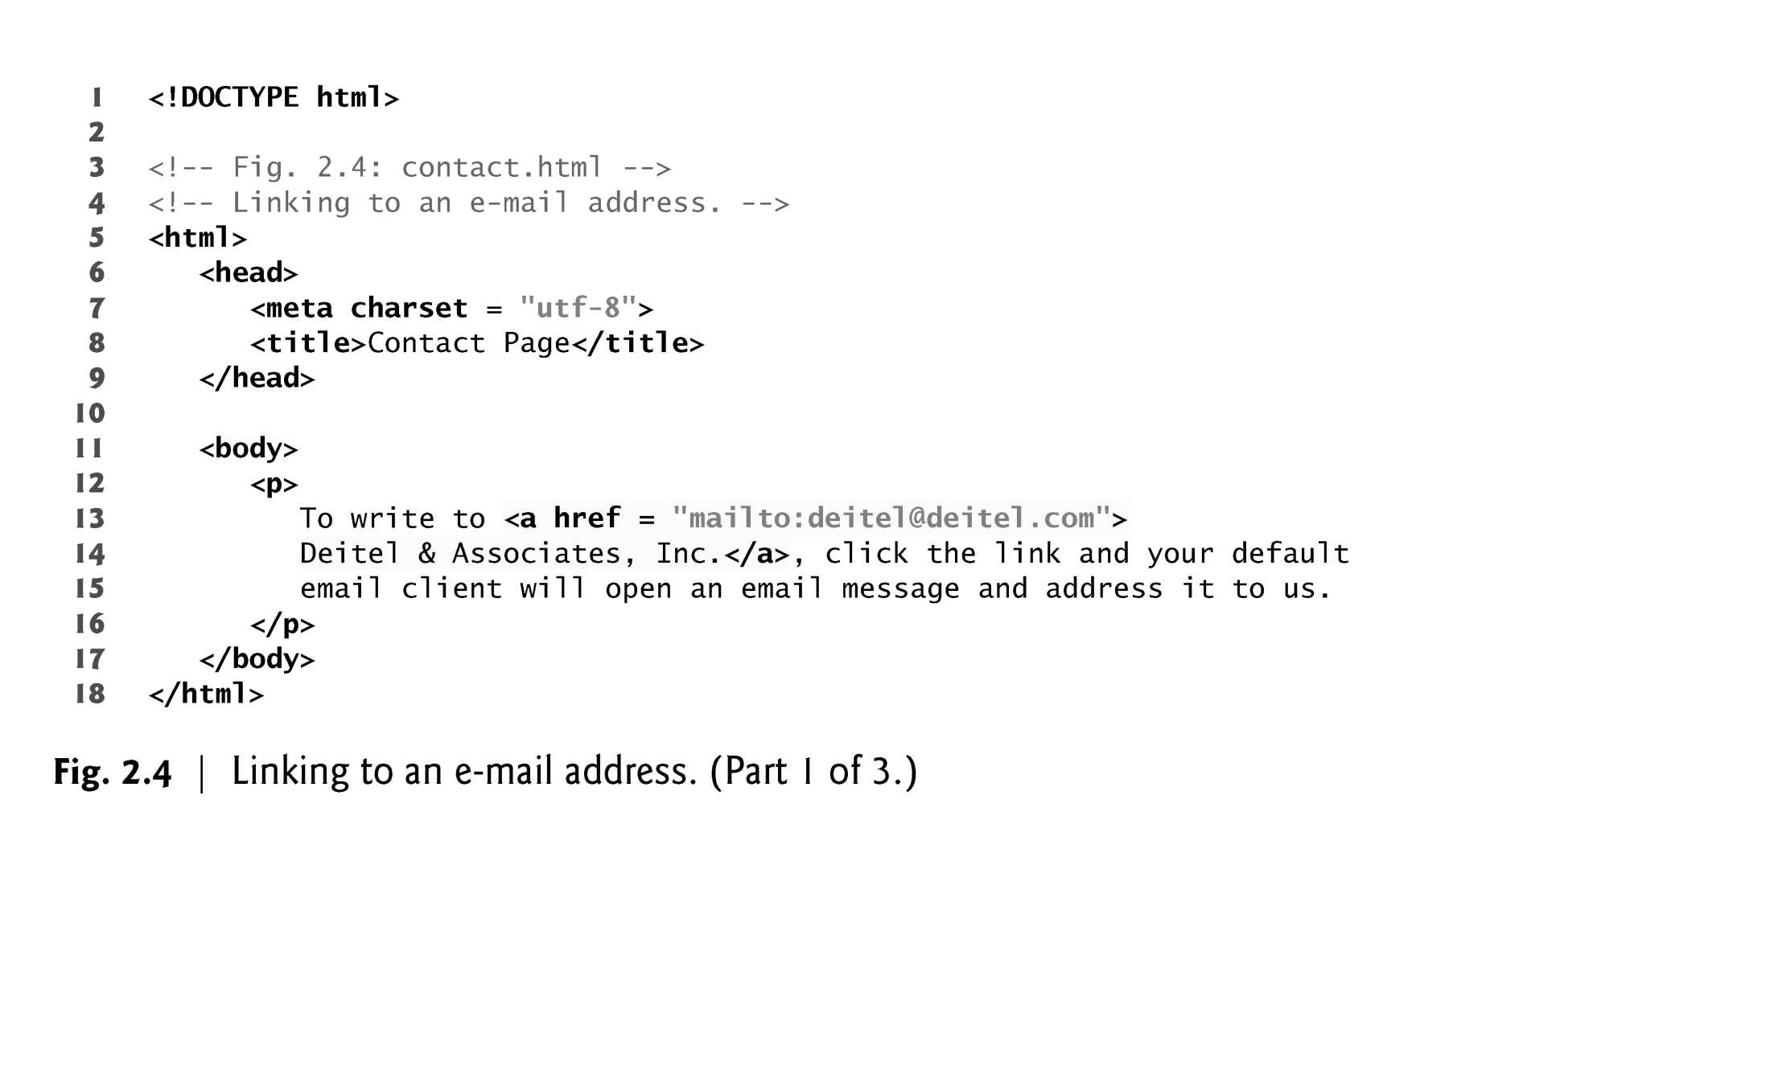
EXAMPLE

Slide 20
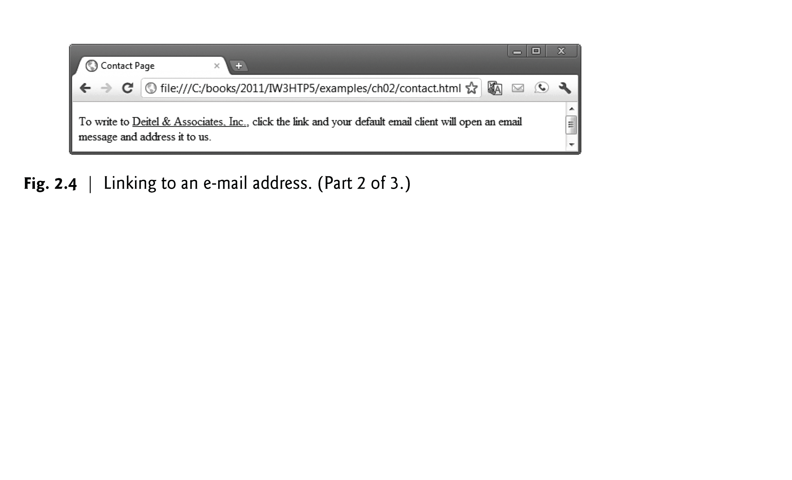
EXAMPLE-Output

Slide 21
2.7 Images
The most popular image formats used by web developers today are PNG (Portable Network Graphics) and JPEG (Joint Photographic Experts Group).
Users can create images using specialized software, such as Adobe Photoshop Express (www.photoshop.com), G.I.M.P. (www.gimp.org), Inkscape (www.inkscape.org) and many more.
Images may also be acquired from various websites, many of which offer royalty-free images.

Slide 22
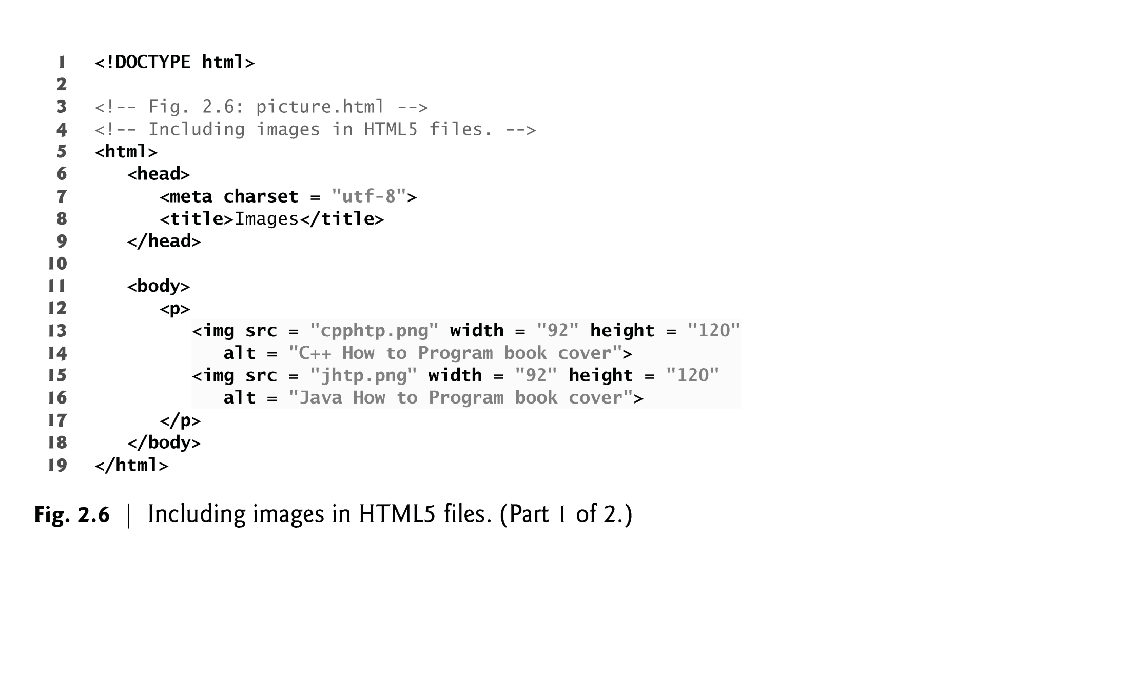
EXAMPLE

Slide 23
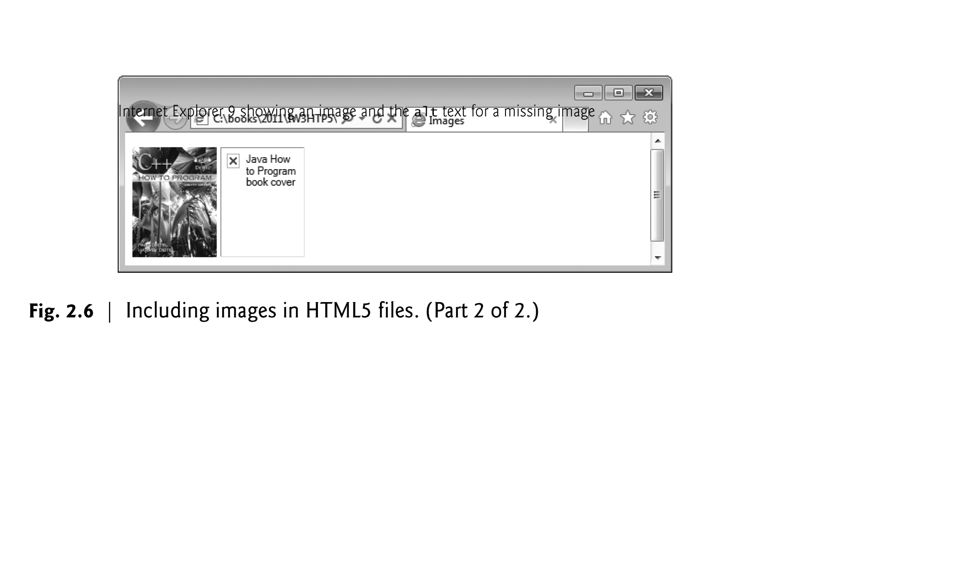
EXAMPLE-Output

Slide 24
2.7 Images (cont.)
The img element’s src attribute specifies an image’s location
Every img element must have an alt attribute, which contains text that is displayed if the client cannot render the image
The alt attribute makes web pages more accessible to users with disabilities, especially vision impairments
Width and height are optional attributes
If omitted, the browser uses the image’s actual width and height
Images are measured in pixels

Slide 25
2.7 Images (Cont.)
alt Attribute
A browser may not be able to render an image.
Every img element in an HTML5 document must have an alt attribute.
If a browser cannot render an image, the browser displays the alt attribute’s value.
The alt attribute is also important for accessibility—speech synthesizer software can speak the alt attribute’s value so that a visually impaired user can understand what the browser is displaying. For this reason, the alt attribute should describe the image’s contents.

Slide 26
2.7 Images (Cont.)
Using Images as Hyperlinks
By using images as hyperlinks, you can create graphical web pages that link to other resources.
In Fig. 2.7, we create five different image hyperlinks.
Clicking an image in this example takes the user to a corresponding web page—one of the other examples in this chapter.

Slide 27
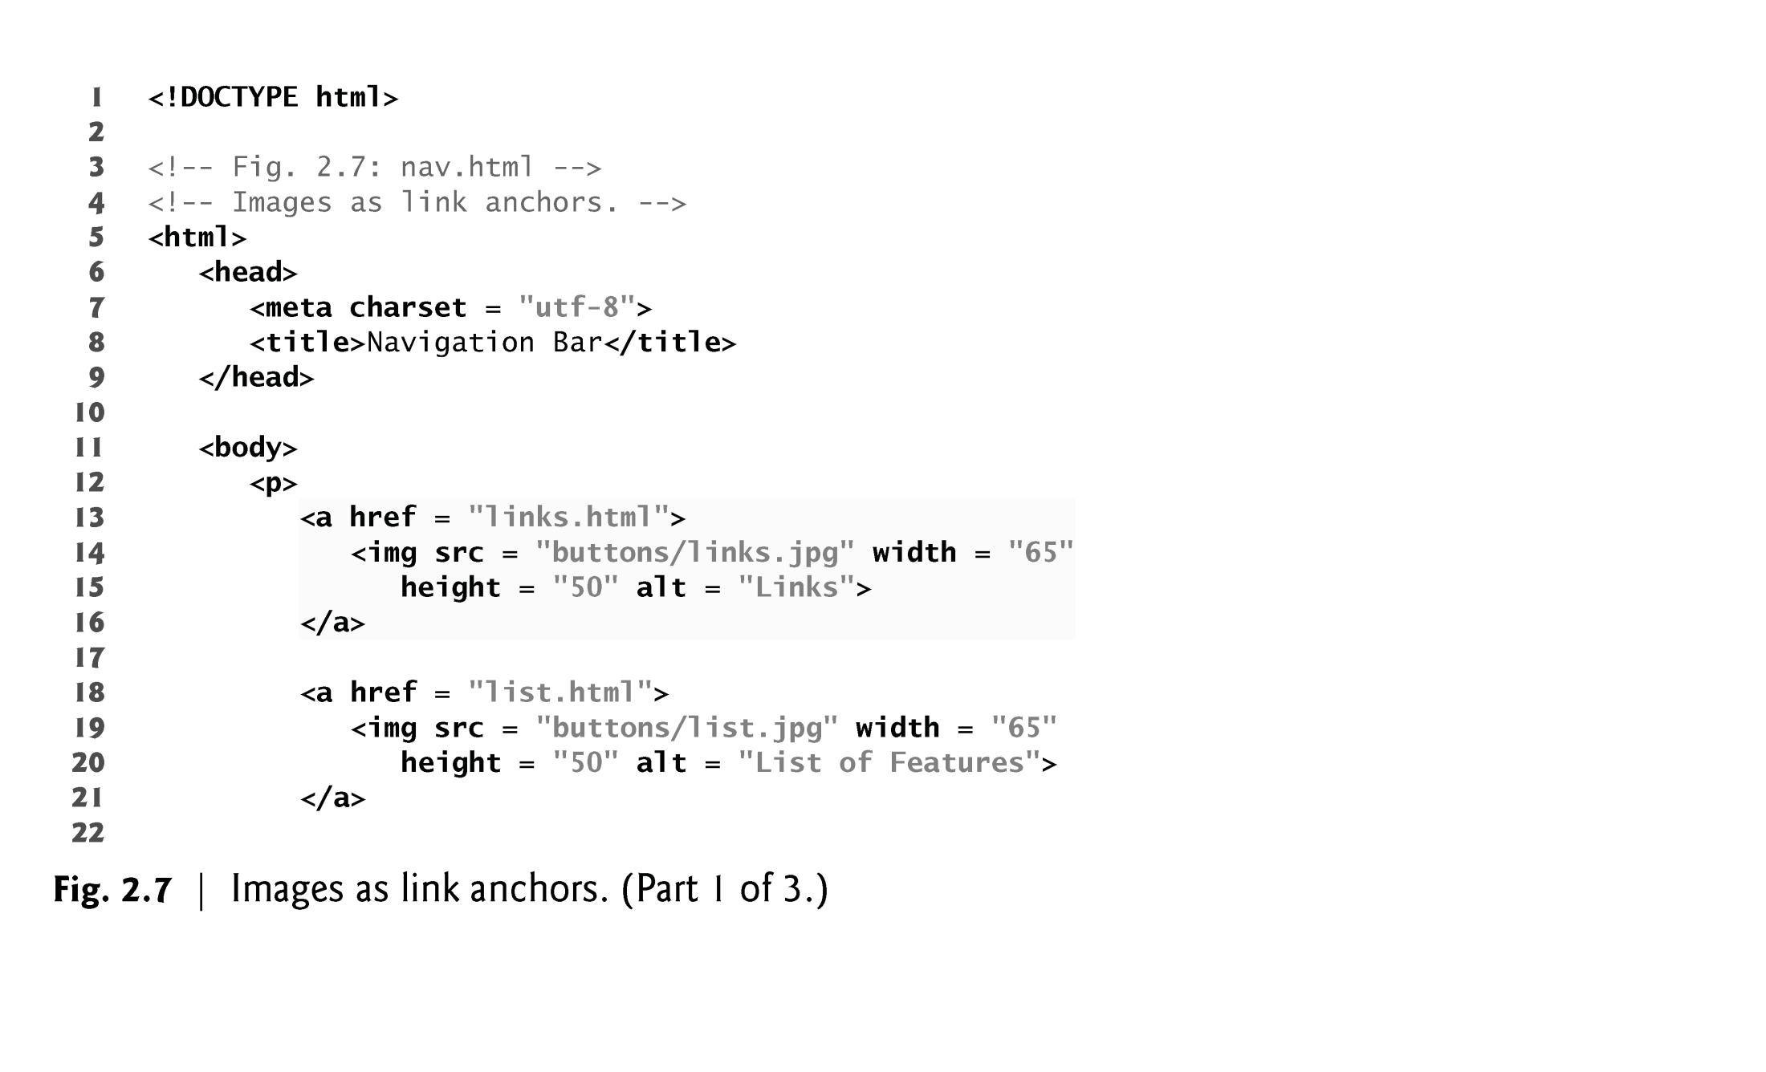
EXAMPLE

Slide 28
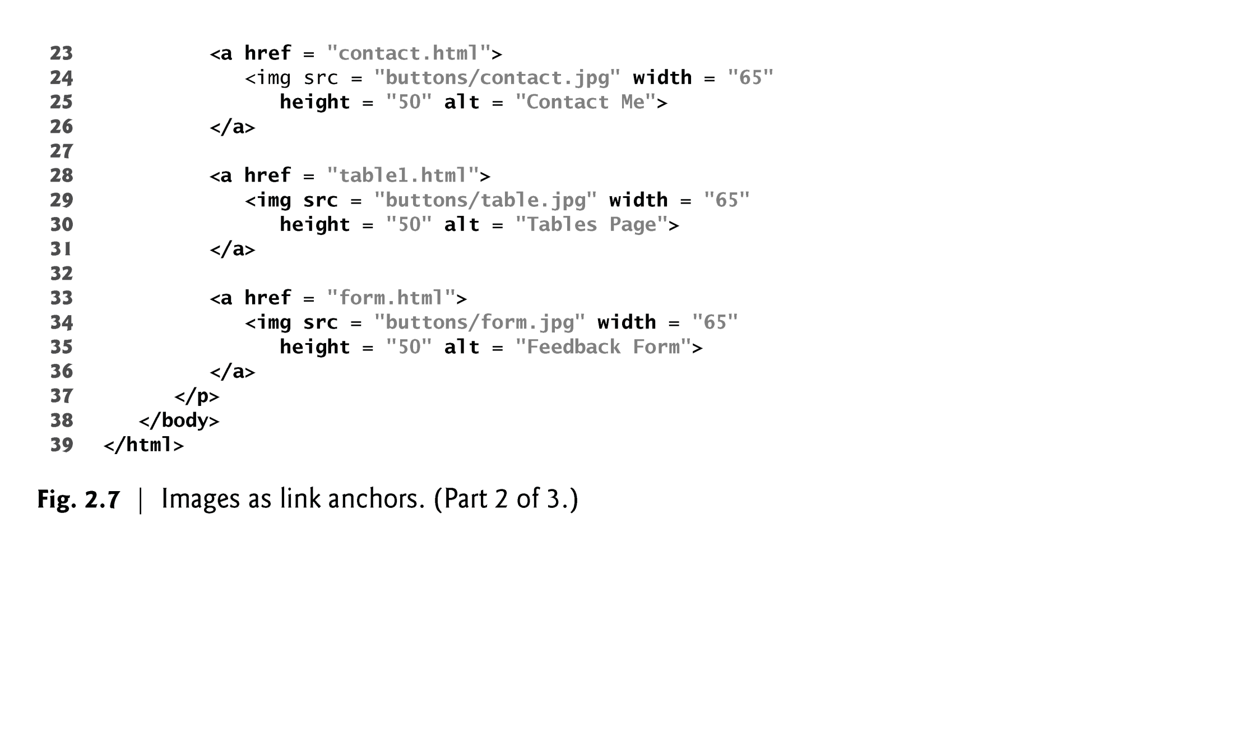
EXAMPLE (cont..)

Slide 29
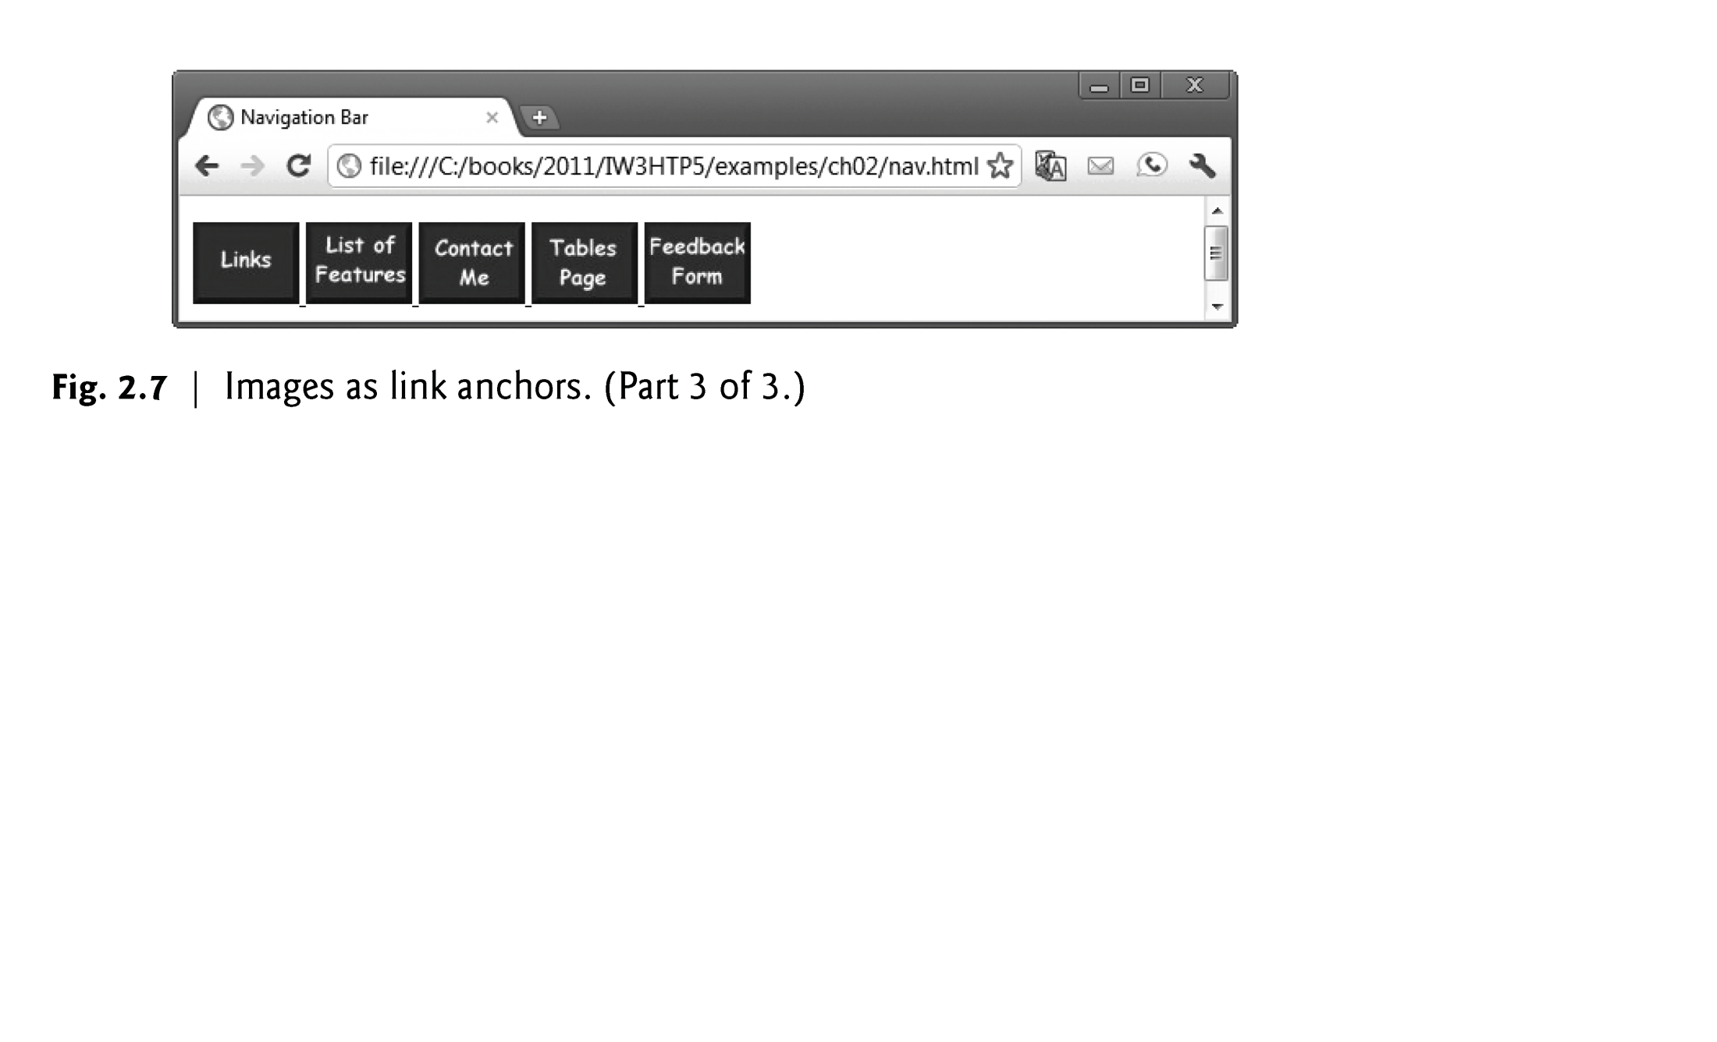
EXAMPLE- Output

Slide 30
2.8 Special Characters and Horizontal Rules
HTML5 provides character entity references (in the form &code;) for representing special characters that cannot be rendered otherwise
The code can be:
Word abbreviations
Numbers
Decimal
Hexadecimal

Slide 31
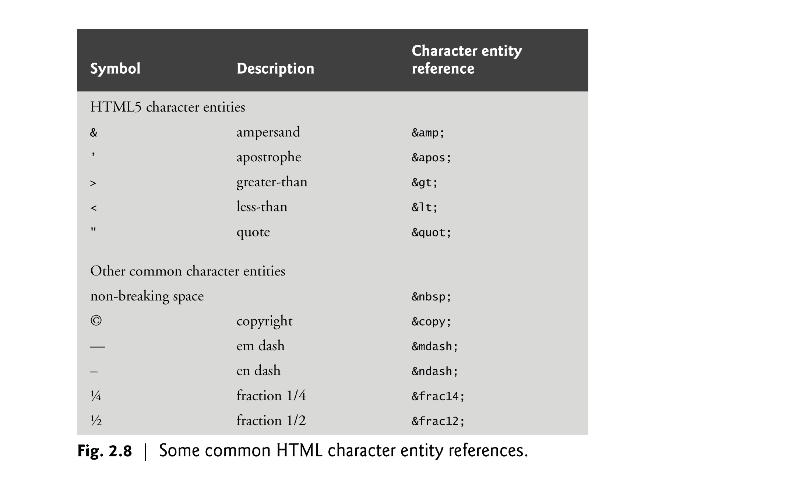
EXAMPLE

Slide 32
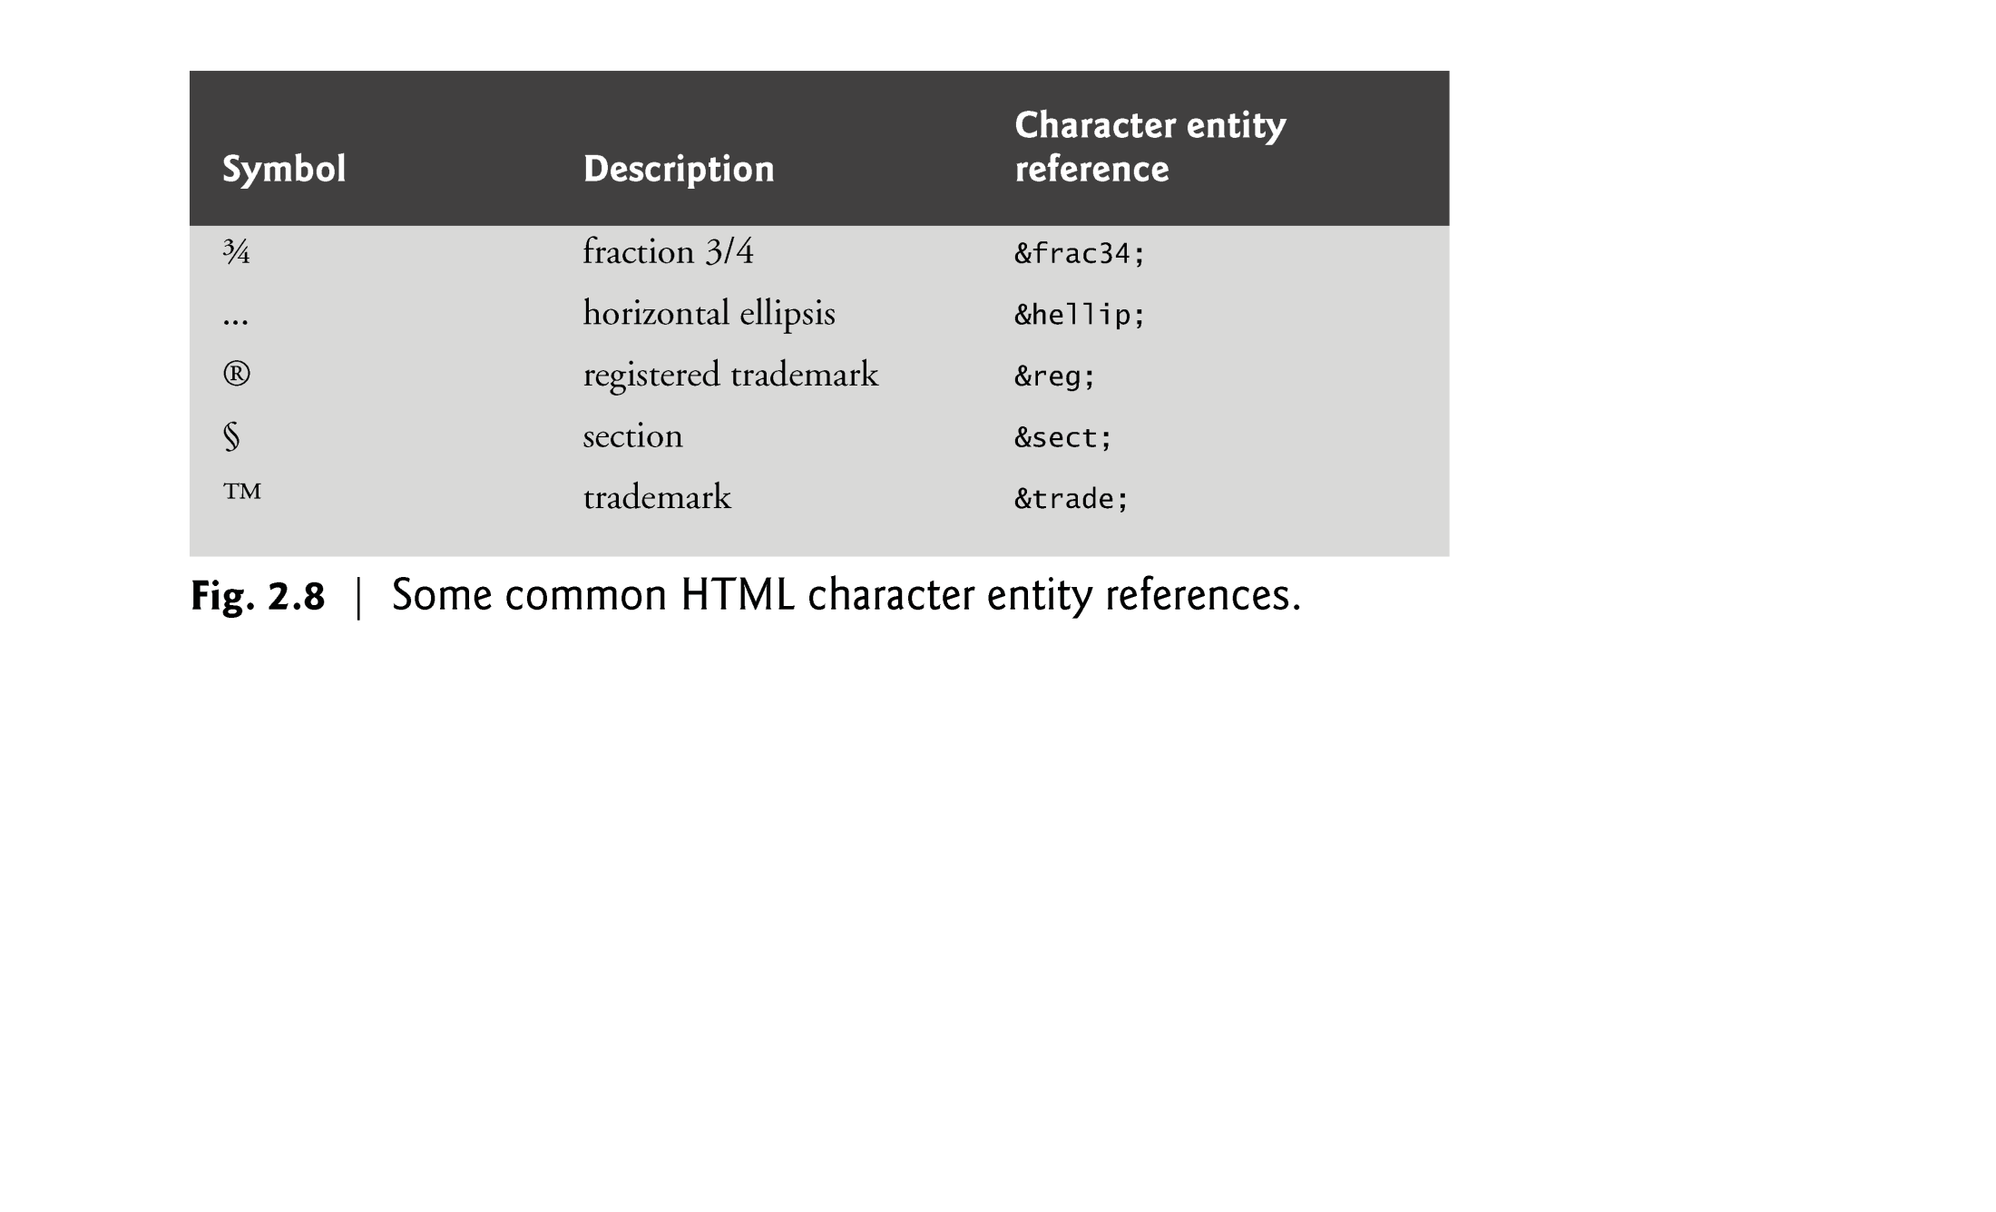
EXAMPLE

Slide 33
2.8 Special Characters and Horizontal Rules (Cont.)
Figure 2.9 demonstrates how to use special characters in an HTML5 document.
For an extensive list of character entities, see
www.w3.org/TR/REC-html40/sgml/entities.html

Slide 34
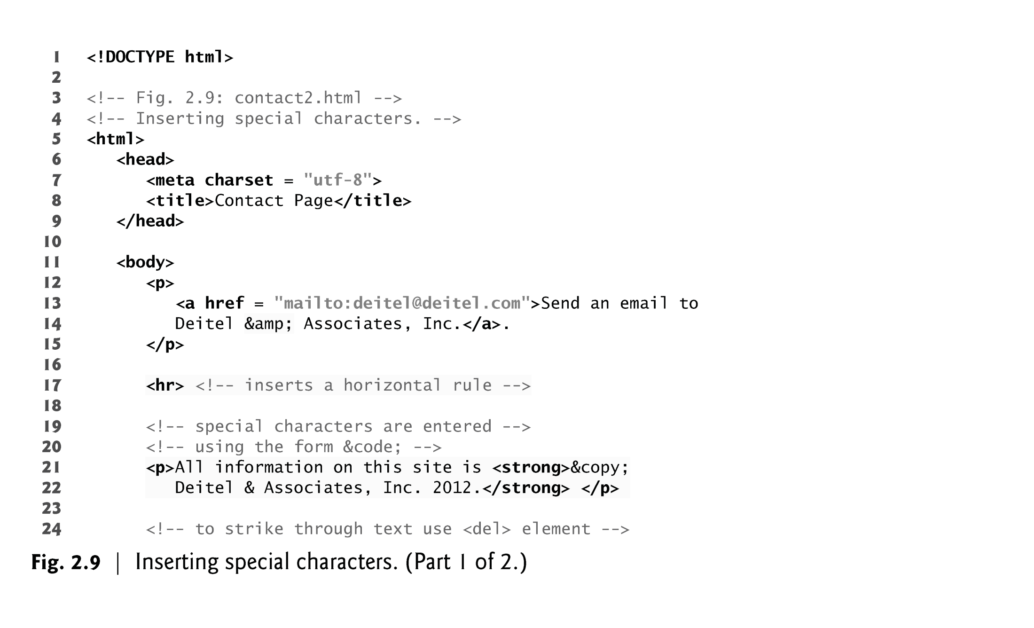
EXAMPLE

Slide 35
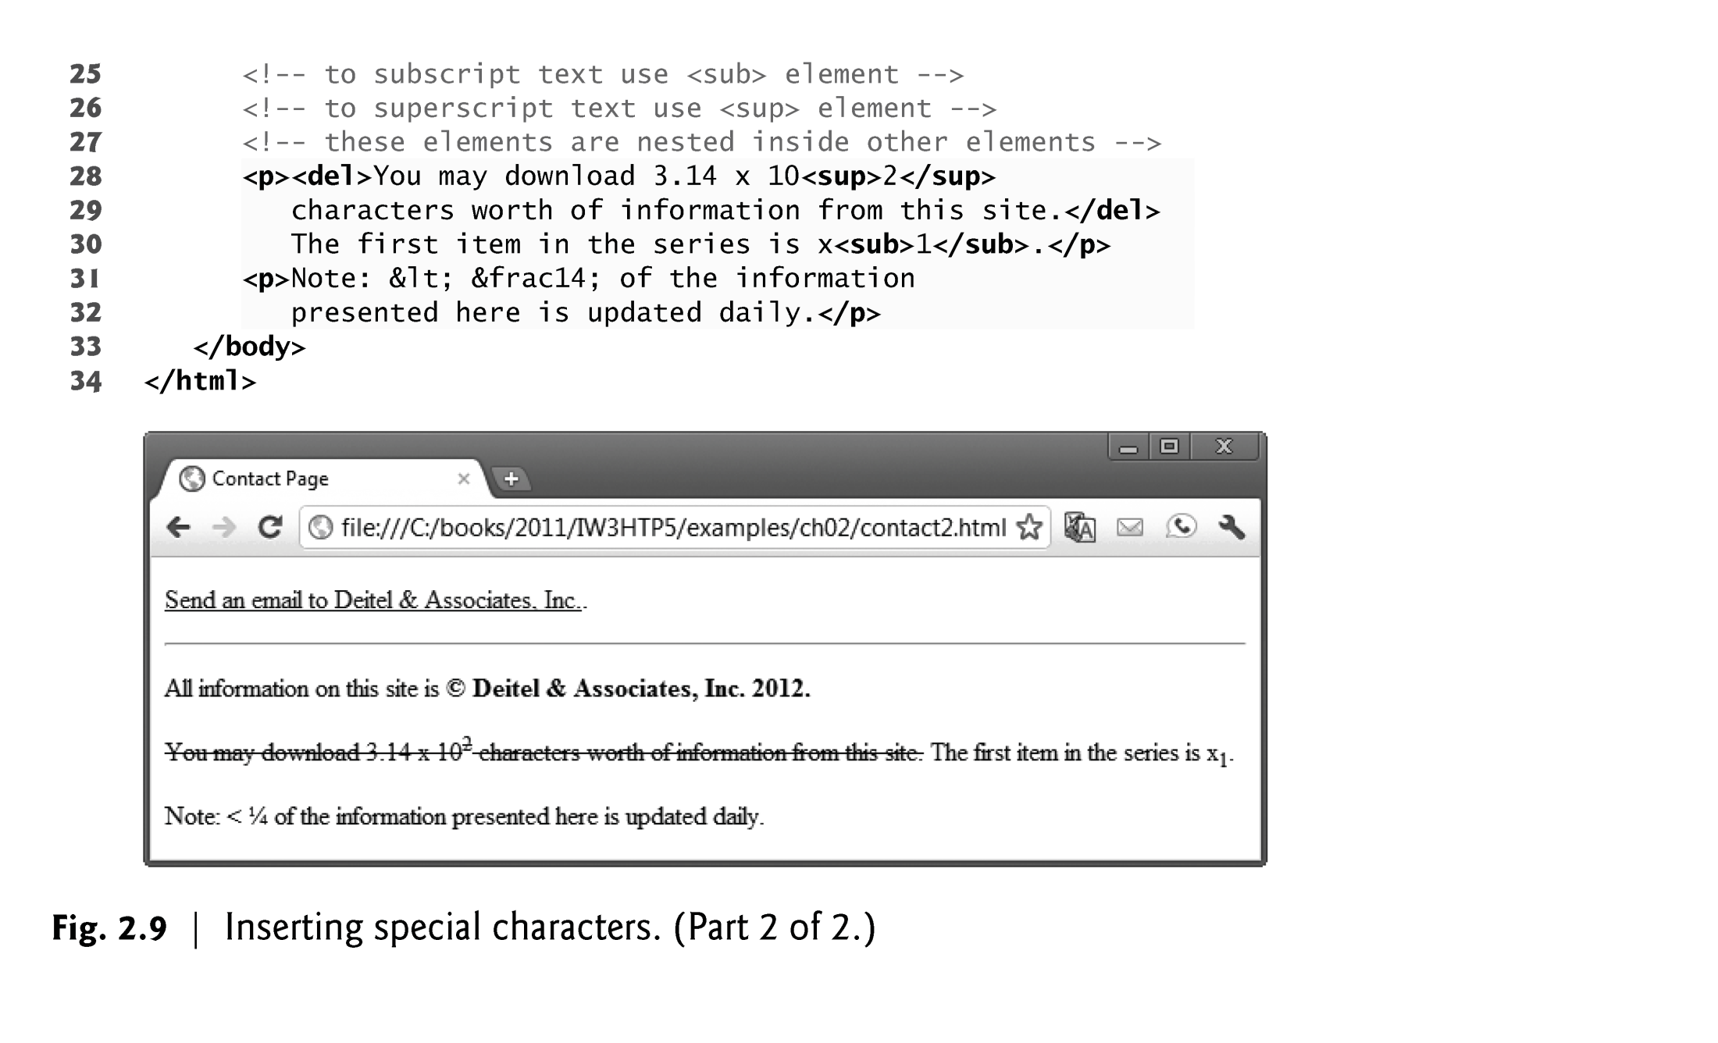
EXAMPLE

Slide 36
2.8 Special Characters and Horizontal Rules (Cont.)
A horizontal rule, indicated by the <hr> tag renders a horizontal line with extra space above and below it in most browsers.
The horizontal rule element should be considered a legacy element and you should avoid using it.
CSS can be used to add horizontal rules and other formatting to documents.
Special characters can also be represented as numeric character references—decimal or hexadecimal (hex) values representing special characters.
For example, the & character is represented in decimal and hexadecimal notation as &#38; and &#x26;, respectively.
Hexadecimal numbers are discussed in Appendix E, Number Systems, which is available online at www.deitel.com/books/iw3htp5/.

Slide 37
2.9 Lists
Unordered list element ul
creates a list in which each item in the list begins with a bullet symbol (typically a disc)
Each entry is an li (list item) element. Most web browsers render these elements with a line break and a bullet symbol at the beginning of the line.

Slide 38
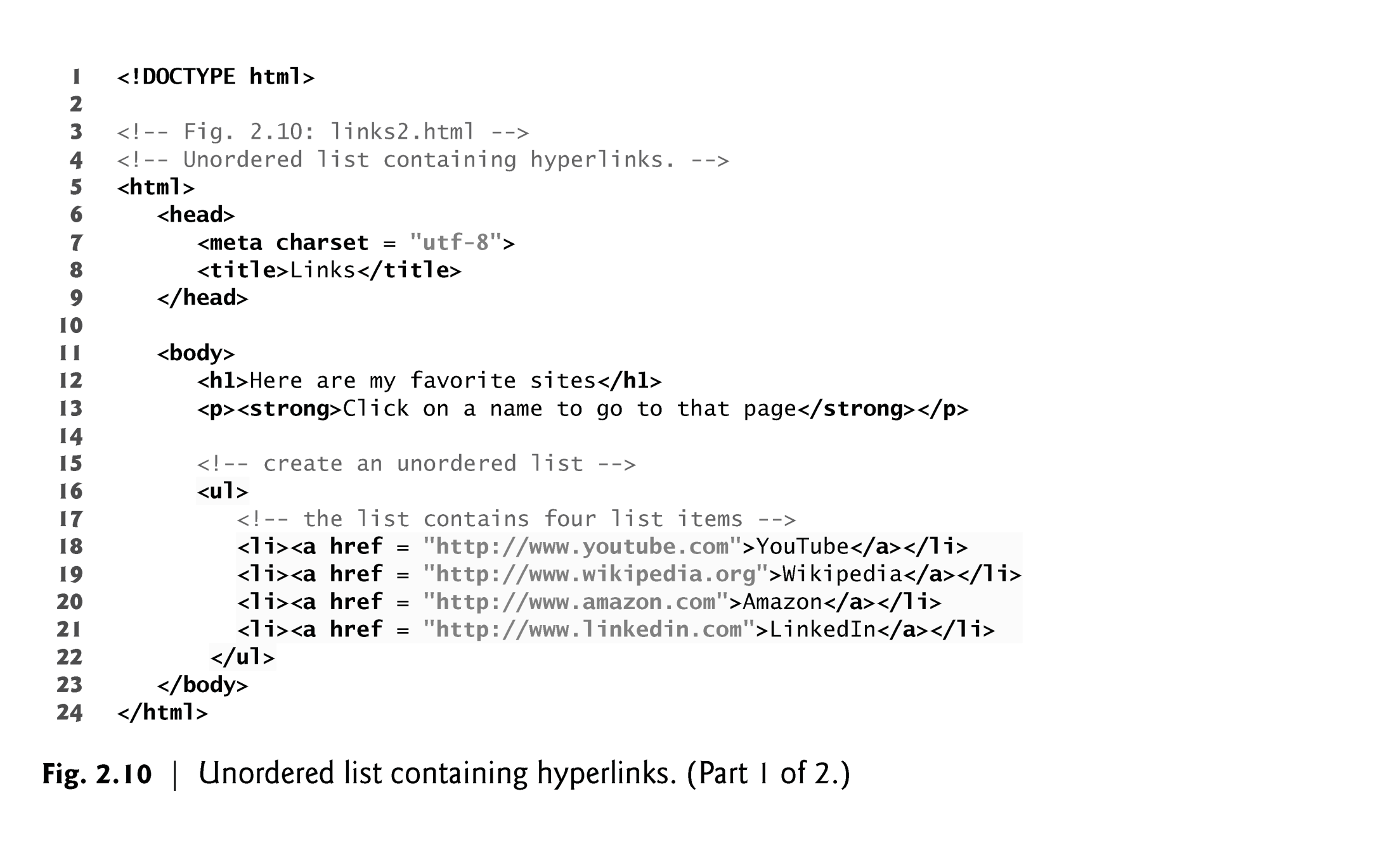

Slide 39
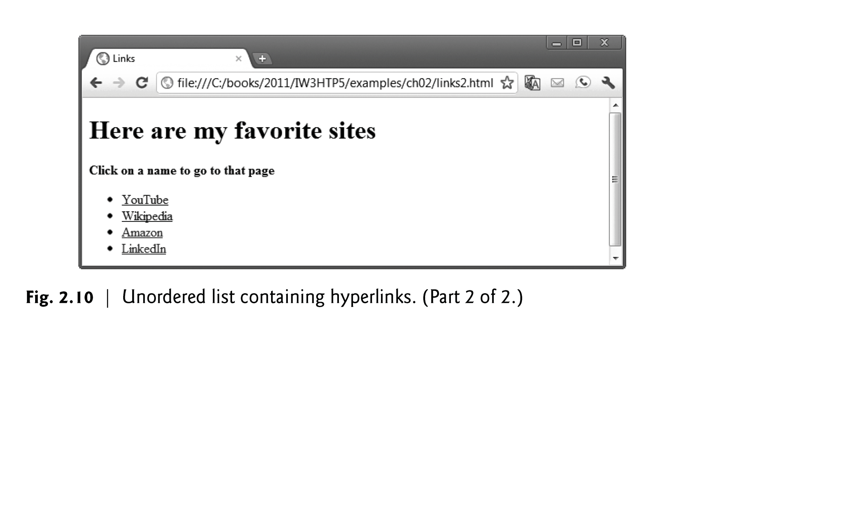
EXAMPLE

Slide 40
2.9 Lists (Cont.)
Nested Lists
Lists may be nested to represent hierarchical relationships, as in a multi-level outline.
Figure 2.11 demonstrates nested lists and ordered lists.
The ordered-list element ol creates a list in which each item begins with a number.

Slide 41
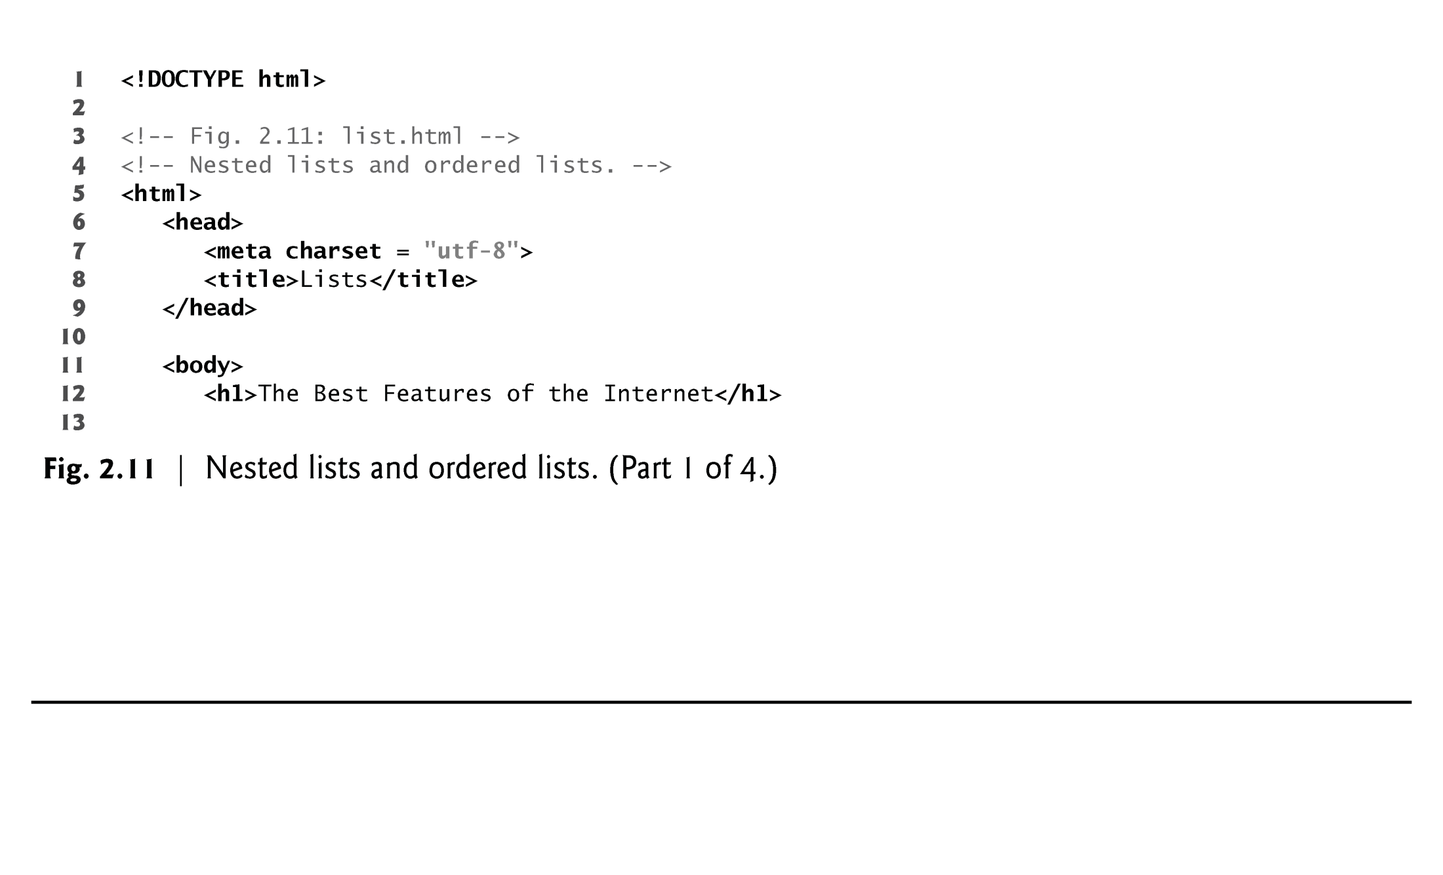
EXAMPLE

Slide 42
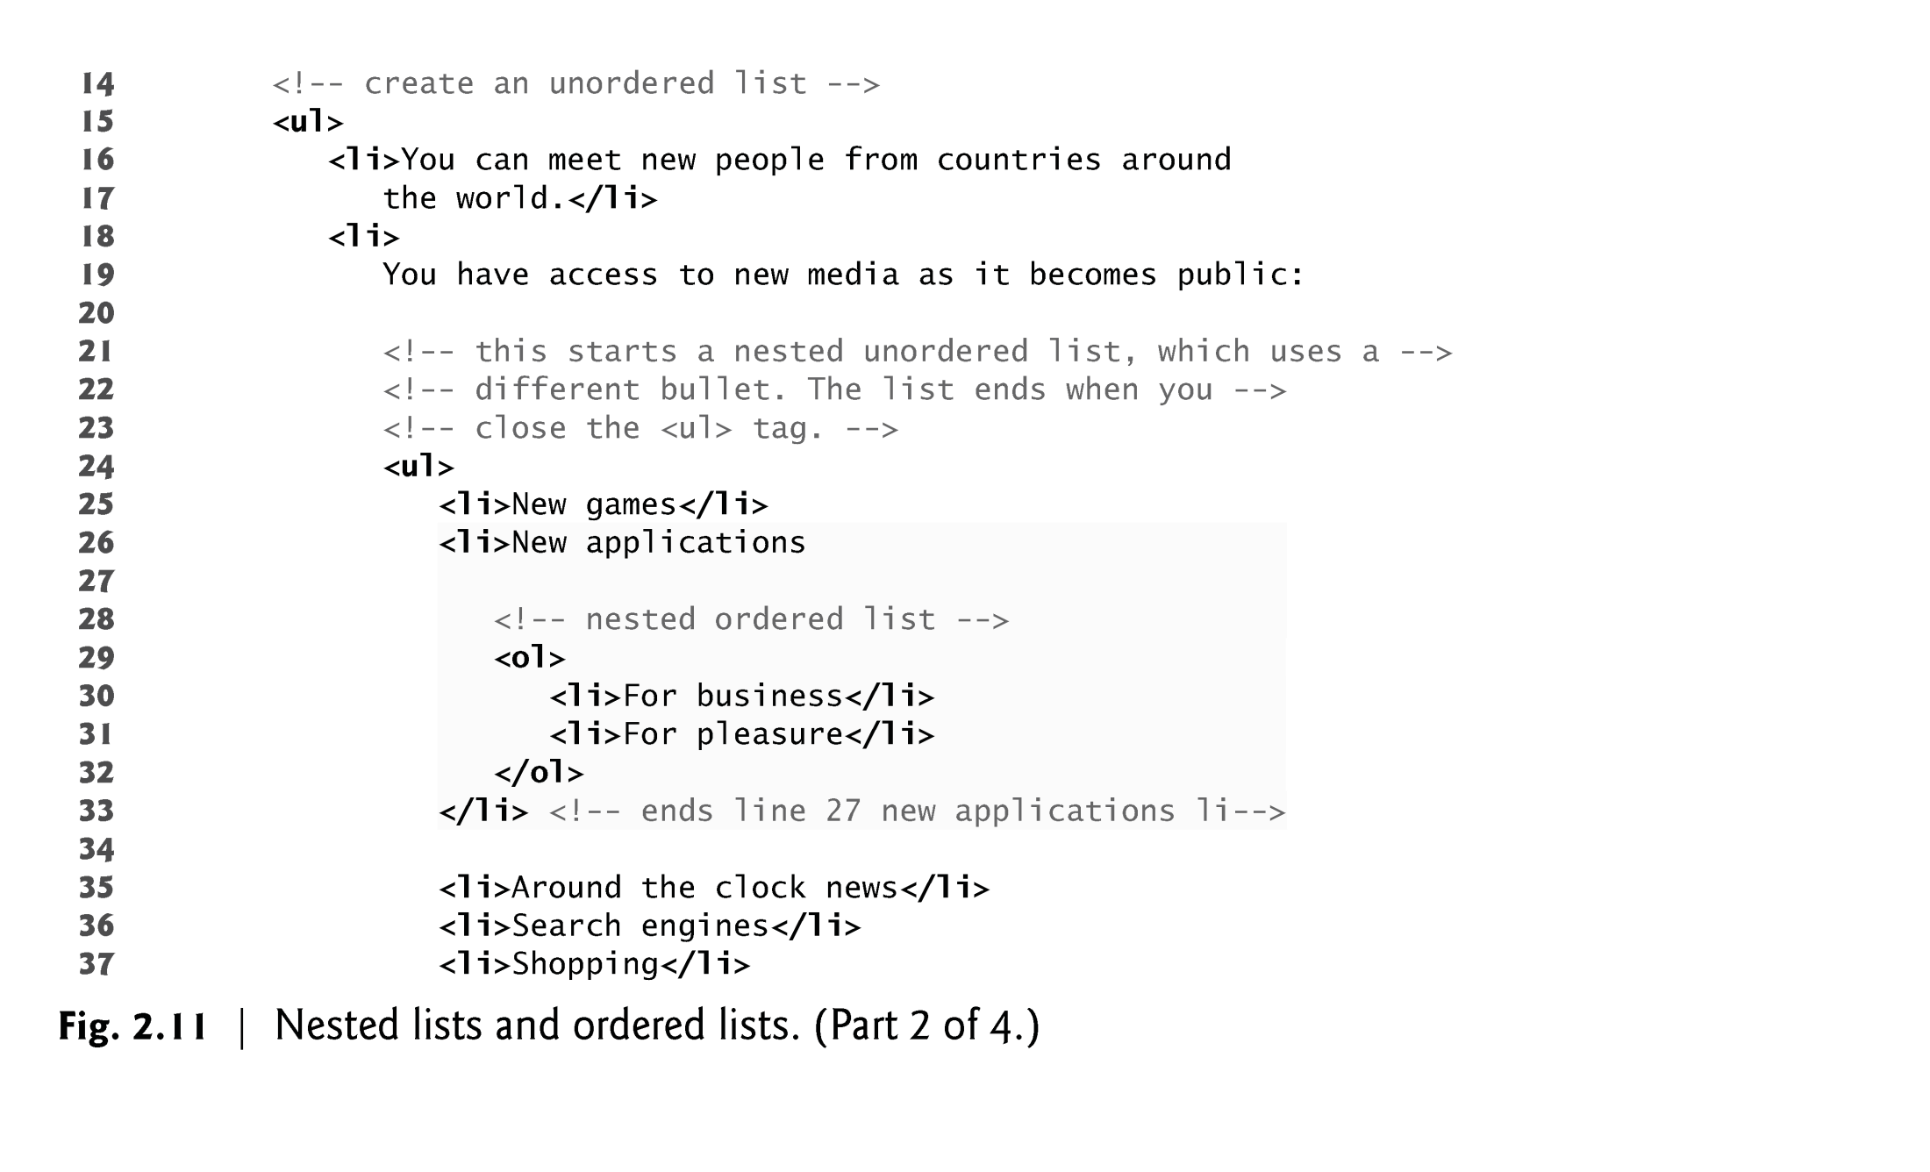
EXAMPLE

Slide 43
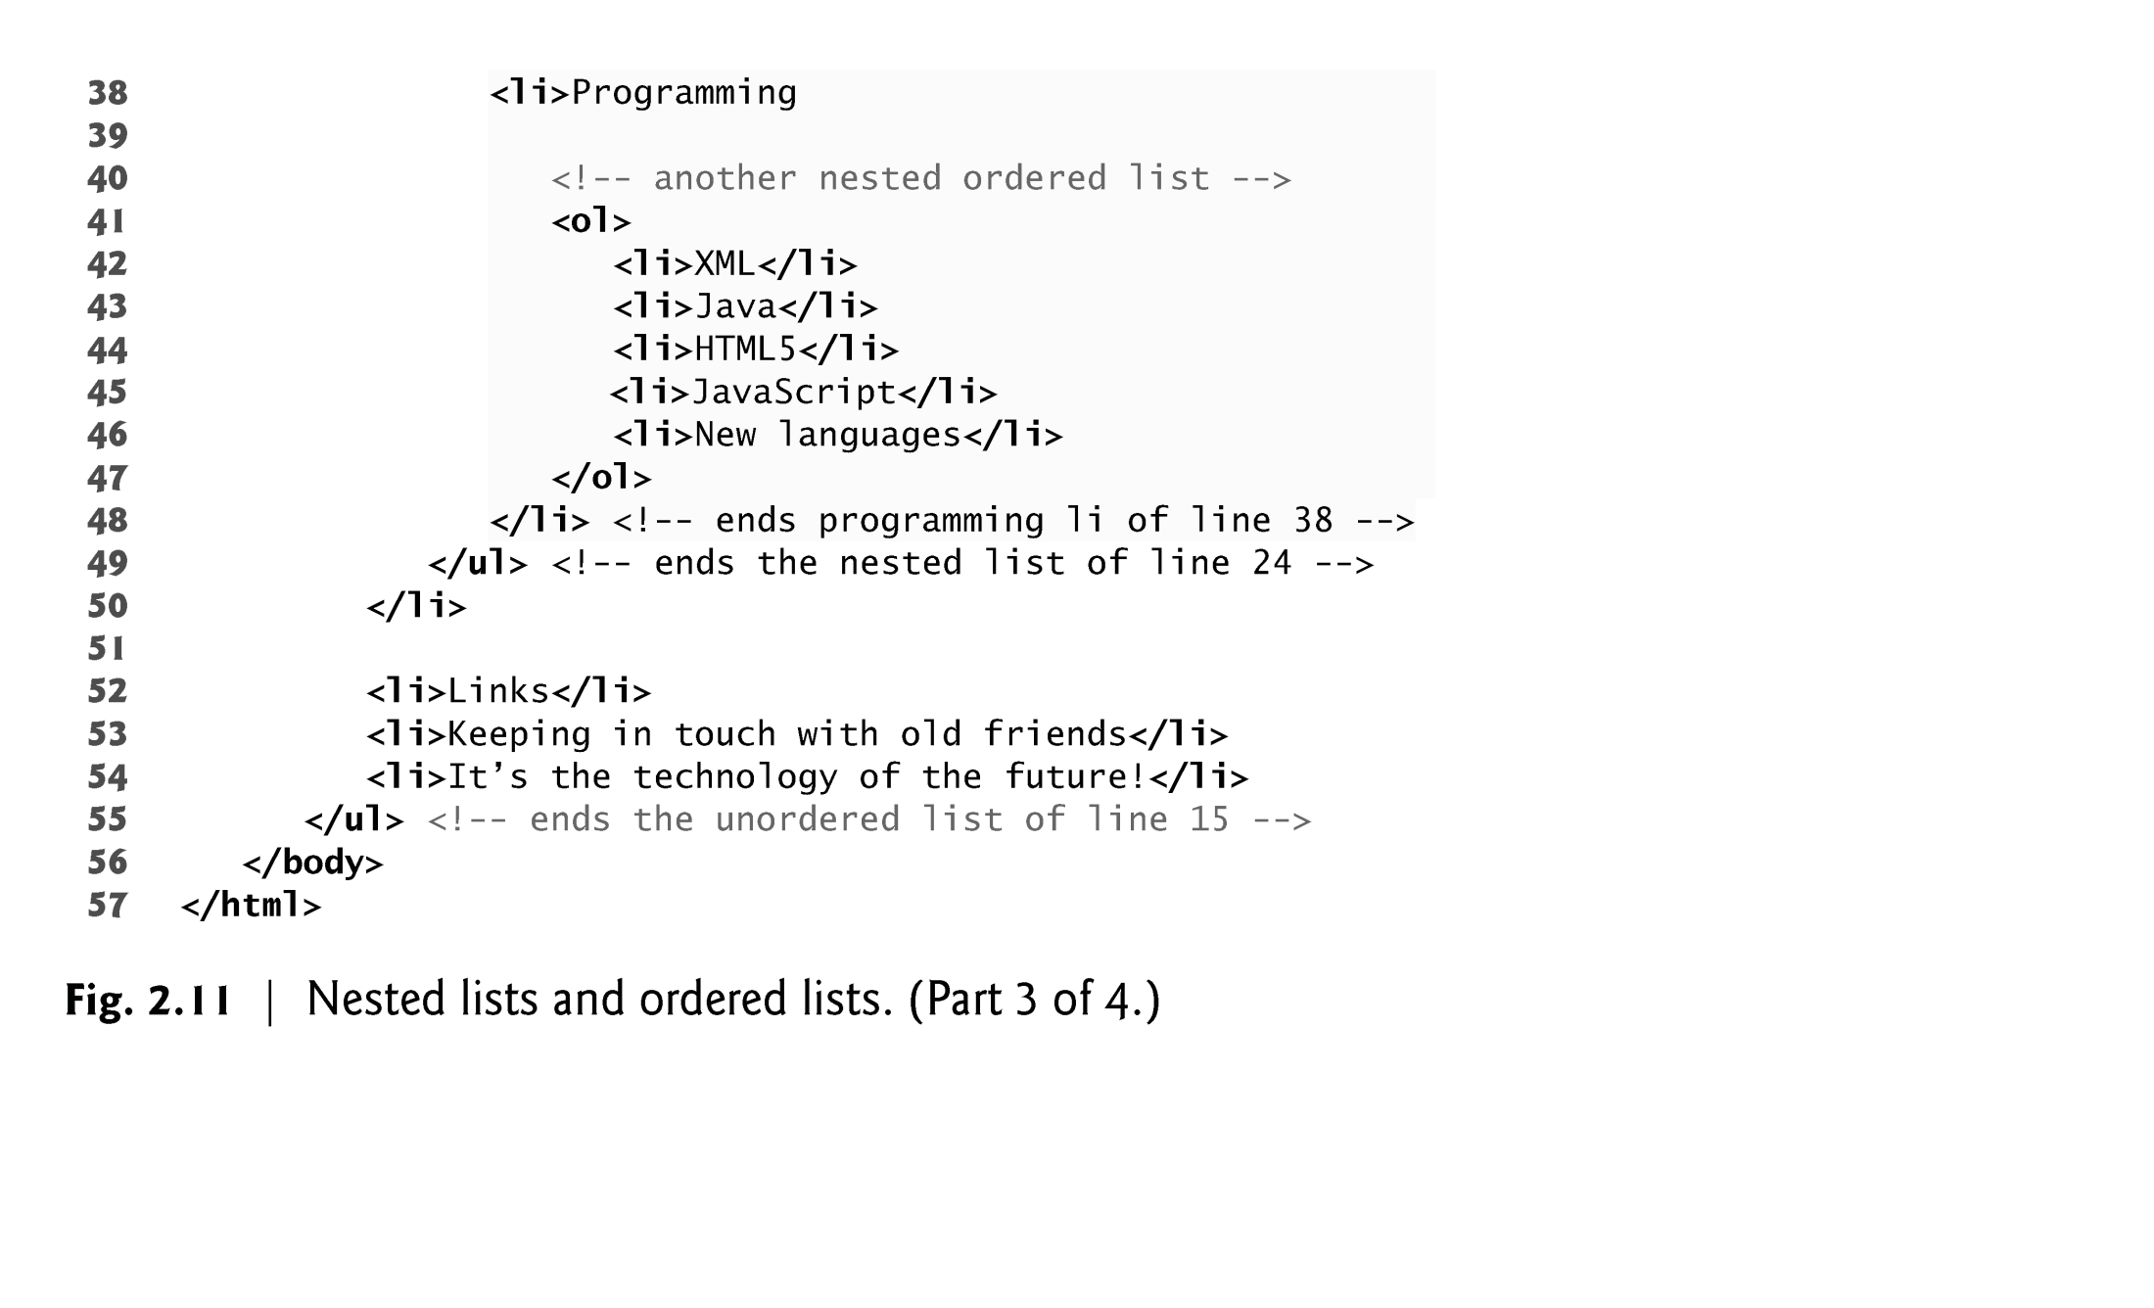
EXAMPLE

Slide 44
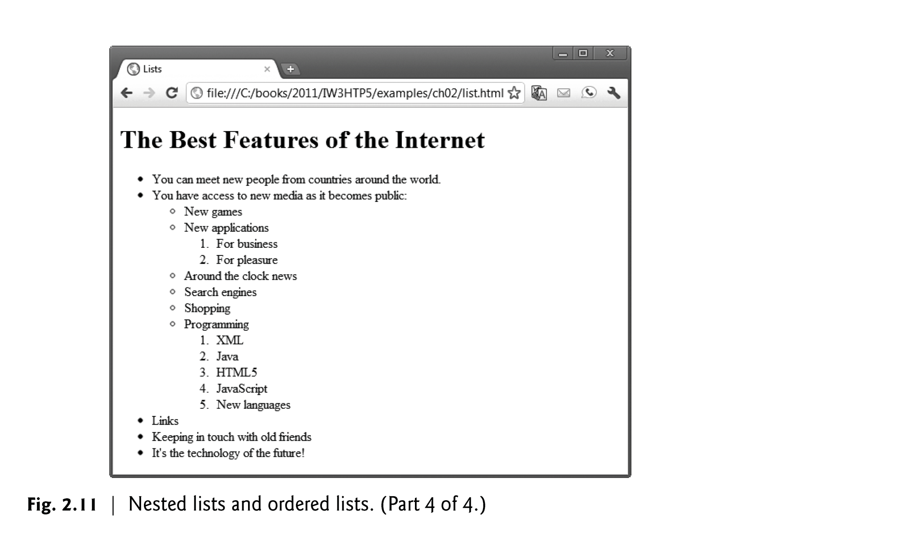
EXAMPLE- Output

Slide 45
2.10 Tables
Tables are frequently used to organize data into rows and columns.
The table element defines an HTML5 table
The summary attribute summarizes the table’s contents and is used by speech devices to make the table more accessible to users with visual impairments.
The caption element specifies a table’s title.
It’s good practice to include a general description of a table’s information in the table element’s summary attribute—one of the many HTML5 features that make web pages more accessible to users with disabilities.
Speech devices use this attribute to make the table more accessible to users with visual impairments.
45
Notes:
45

Slide 46
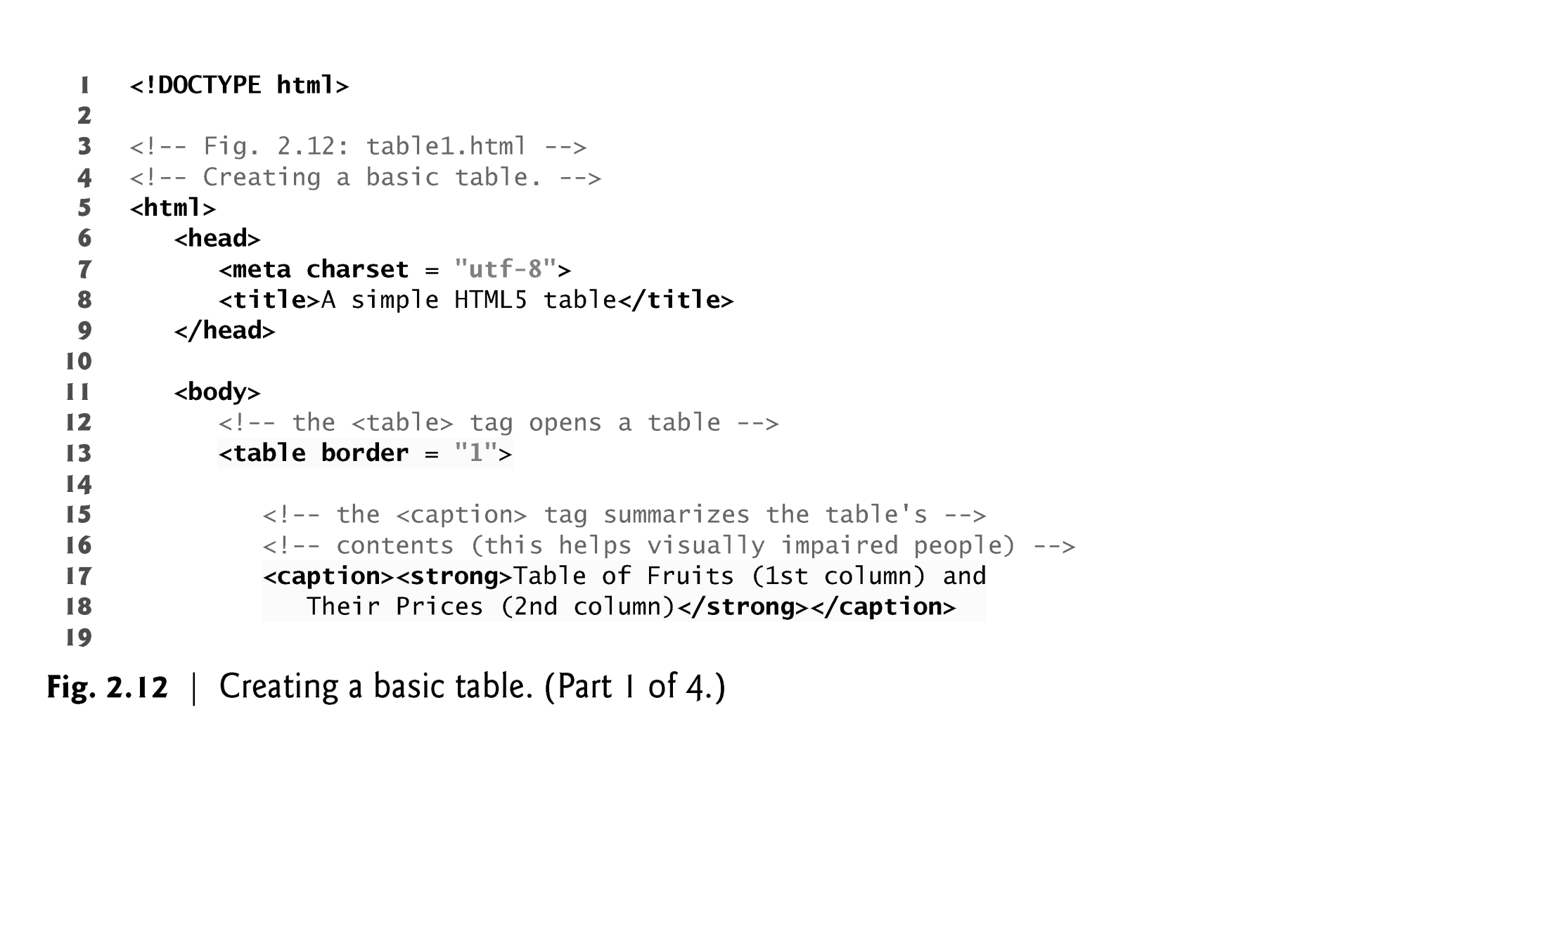

Slide 47
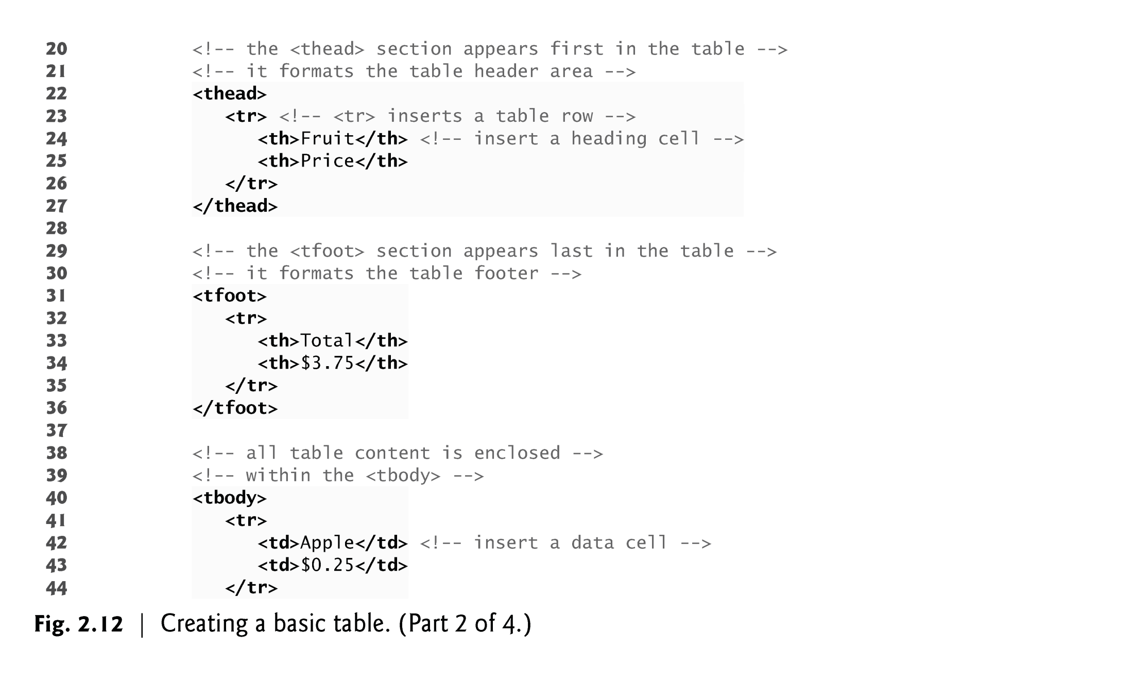

Slide 48
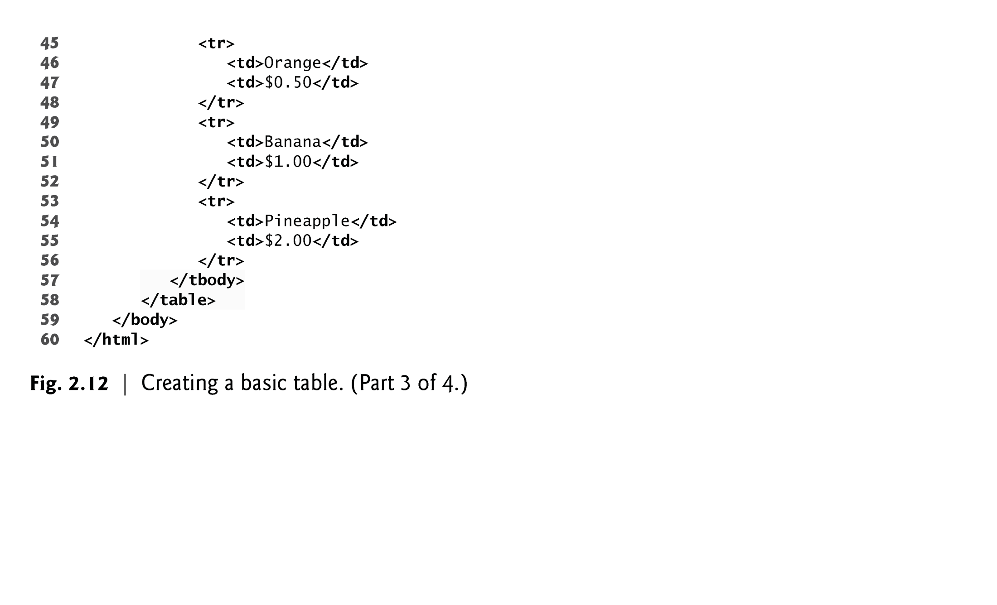

Slide 49
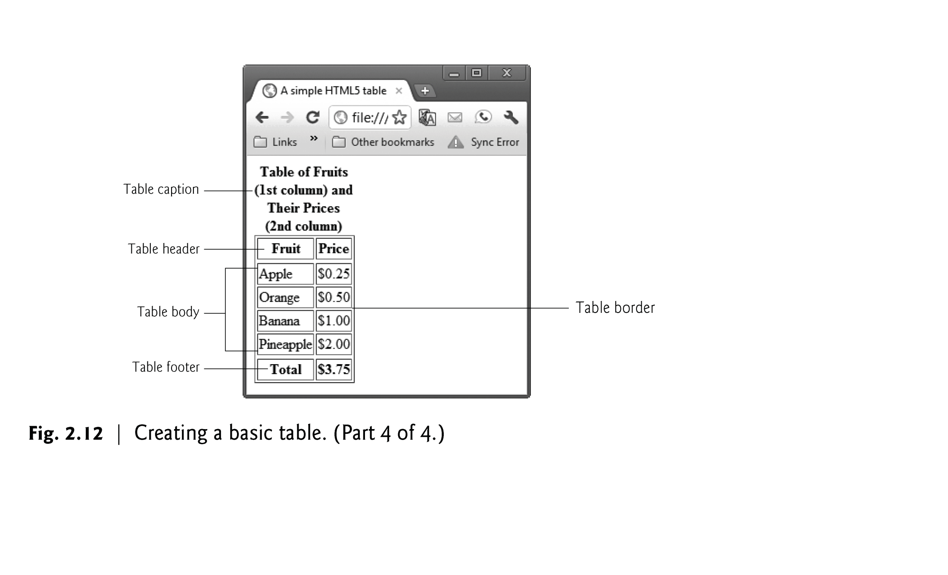

Slide 50
2.10 Tables (Cont.)
A table can be split into three distinct sections:
Head (thead element)
Table titles
Column headers
Body (tbody element)
Primary table data
Table Foot (tfoot element)
Calculation results
Footnotes
Above body section in the code, but displays at the bottom in the page
50
Notes:
50

Slide 51
2.10 Tables (Cont.)
tr Element
Defines individual table rows
Element th
Defines a header cell
Td Element
Contains table data elements
51
Notes:
51

Slide 52
2.10 Tables (Cont.)
Using rowspan and colspan with Tables
Figure 2.13 introduces two new attributes that allow you to build more complex tables.
You can merge data cells with the rowspan and colspan attributes
The values of these attributes specify the number of rows or columns occupied by the cell.
Can be placed inside any data cell or table header cell.
The br element is render as a line break in most browsers—any markup or text following a br element is rendered on the next line.
Like the img element, br is an example of a void element.
Like the hr element, br is considered a legacy formatting element that you should avoid using—in general, formatting should be specified using CSS.
52
Notes:
52

Slide 53
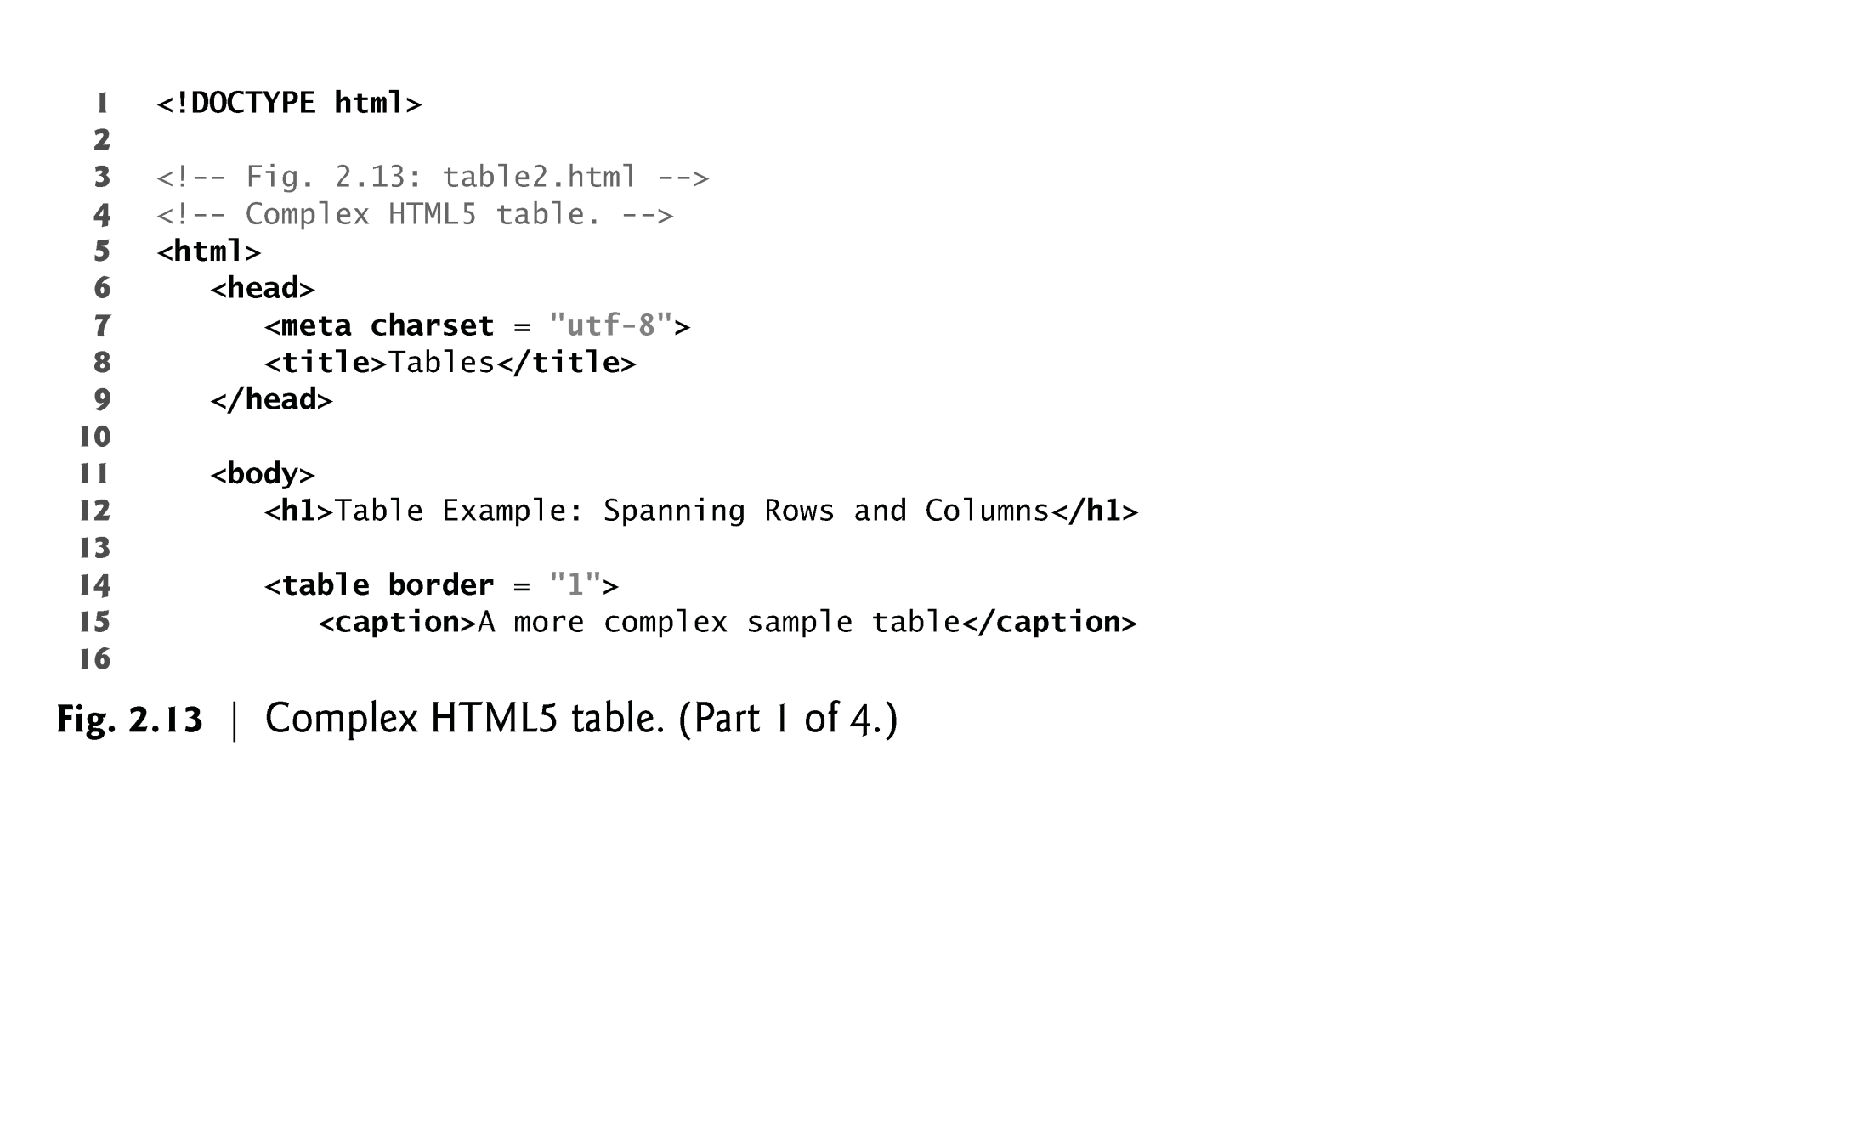
EXAMPLE

Slide 54
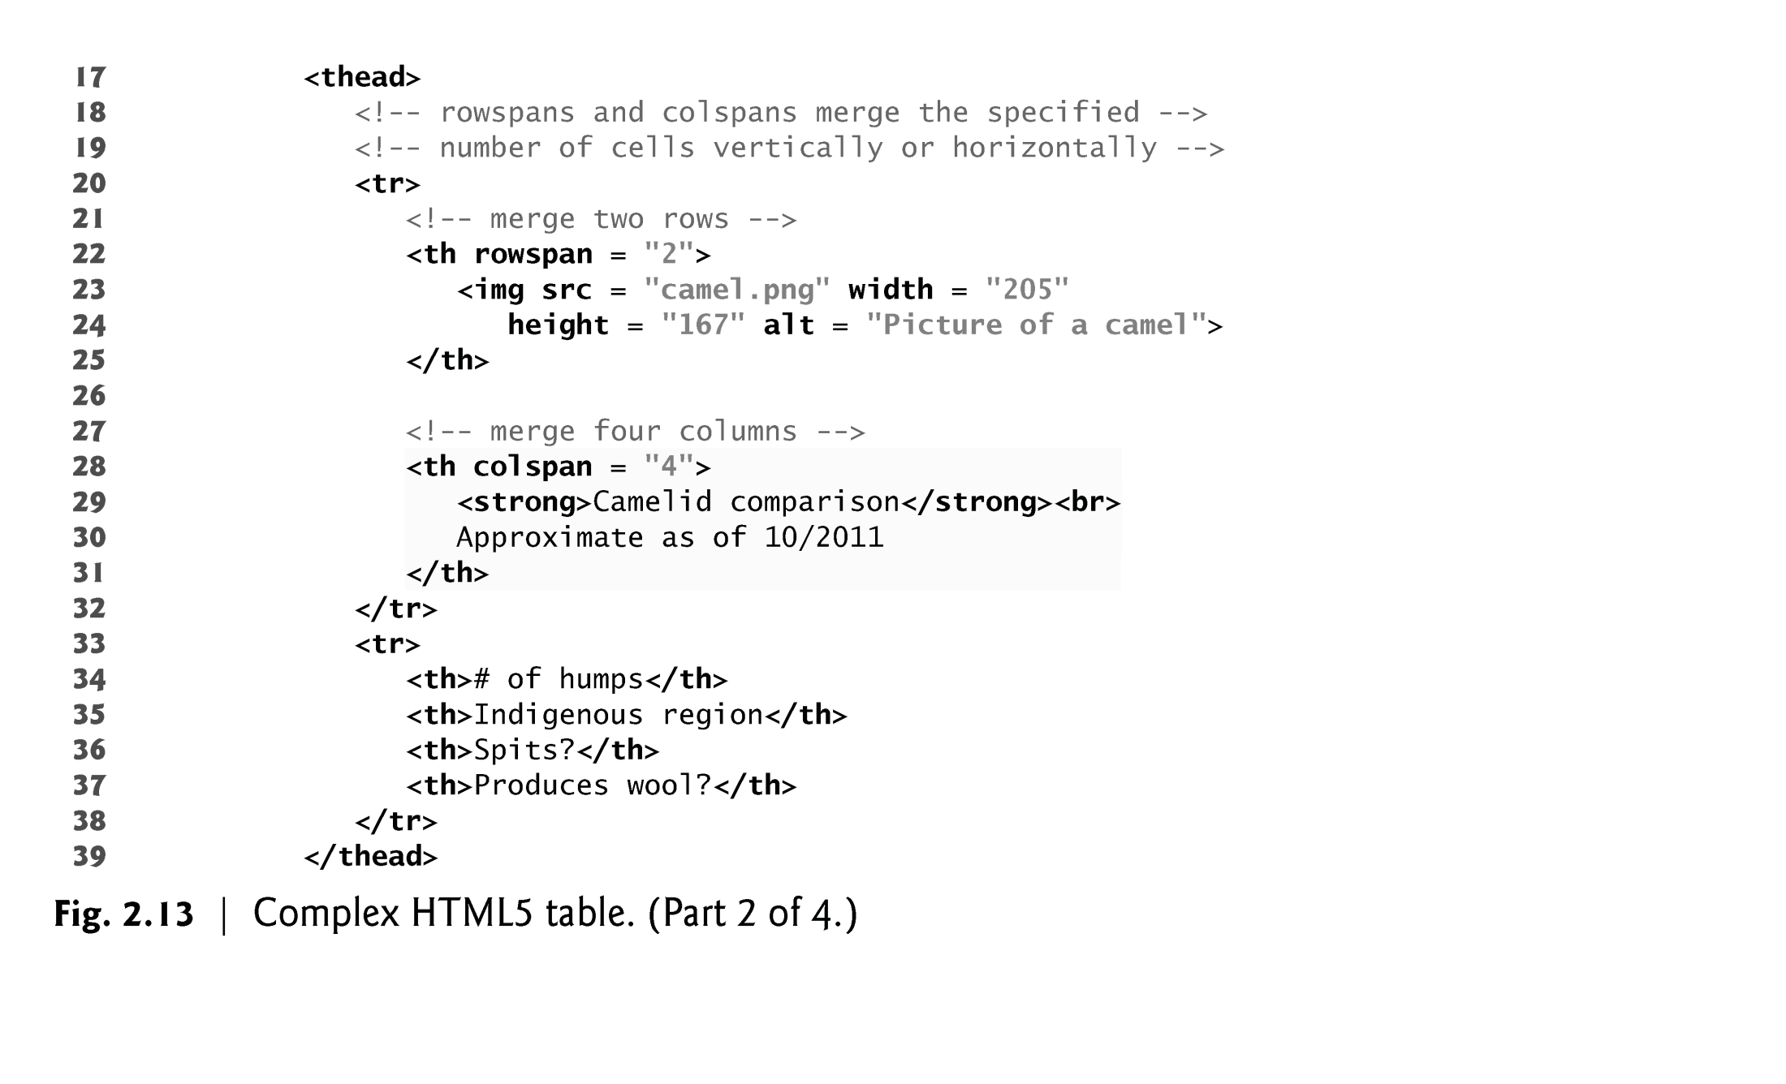
EXAMPLE-Cont…

Slide 55
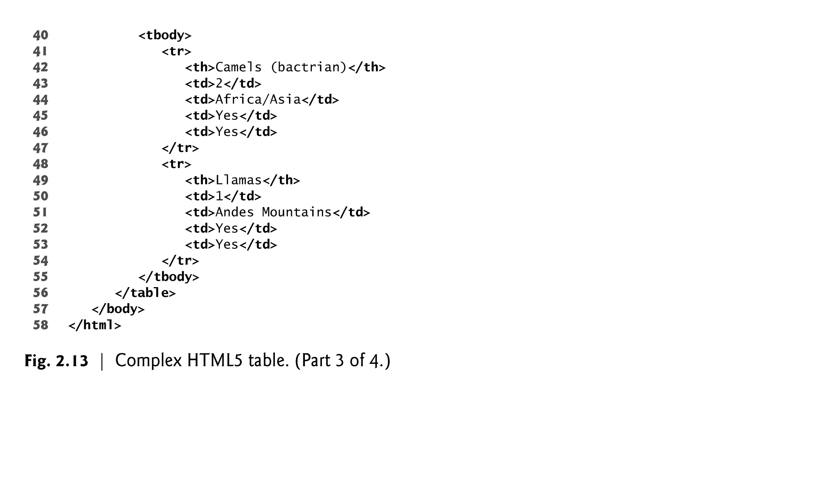
EXAMPLE-Cont…

Slide 56
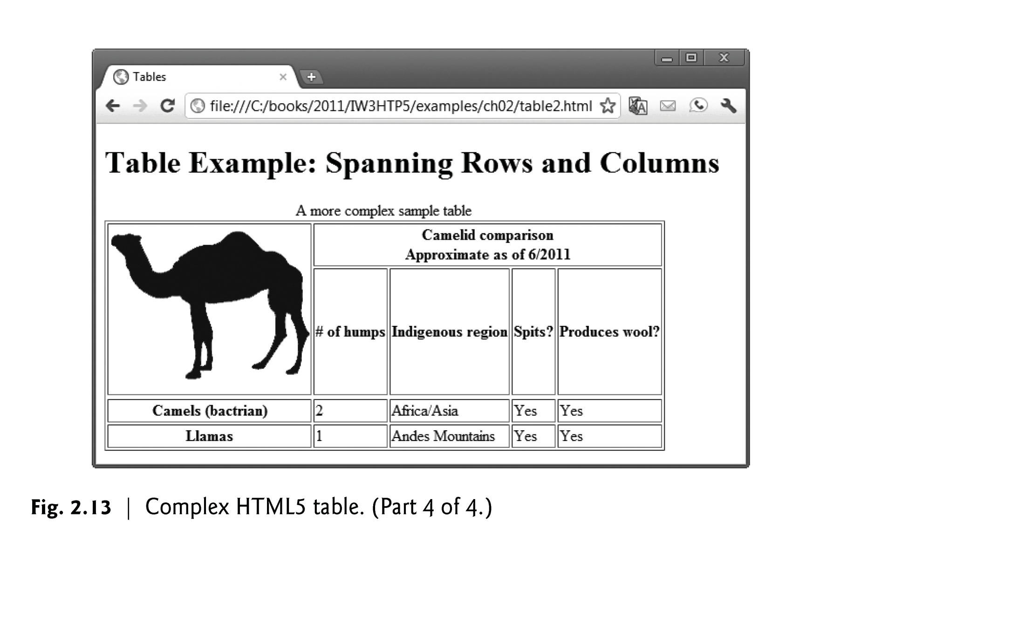
EXAMPLE-Output

Slide 57
2.11 Forms
HTML5 provides forms for collecting information from users.
Figure 2.14 is a simple form that sends data to the web server for processing.
57
Notes:
57

Slide 58
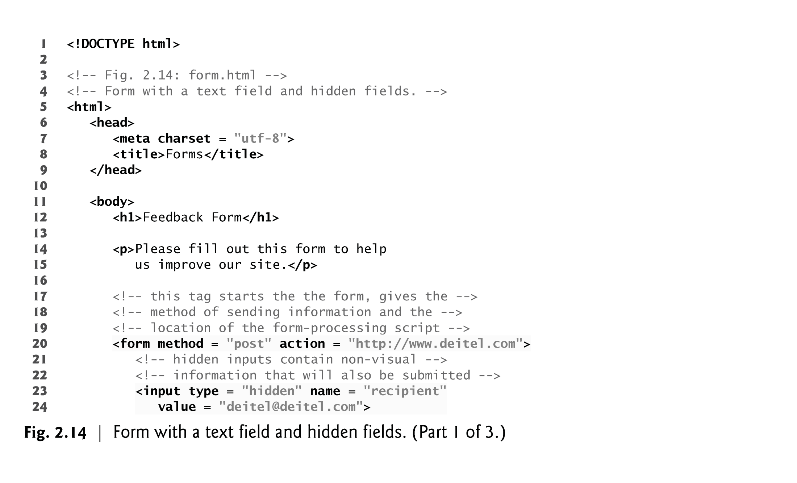
EXAMPLE

Slide 59
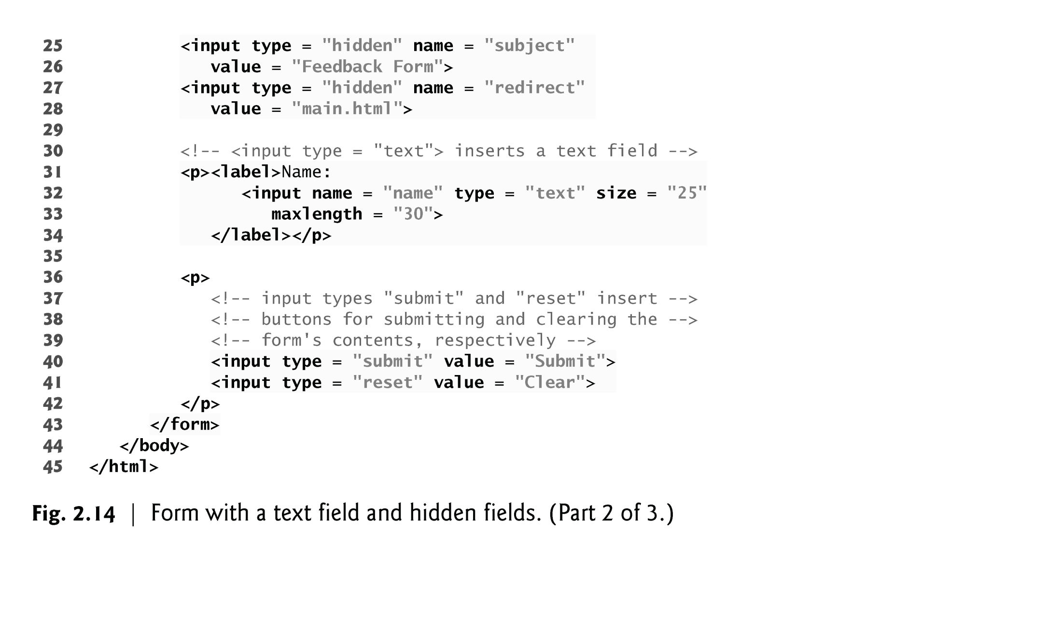
EXAMPLE (Cont…)

Slide 60
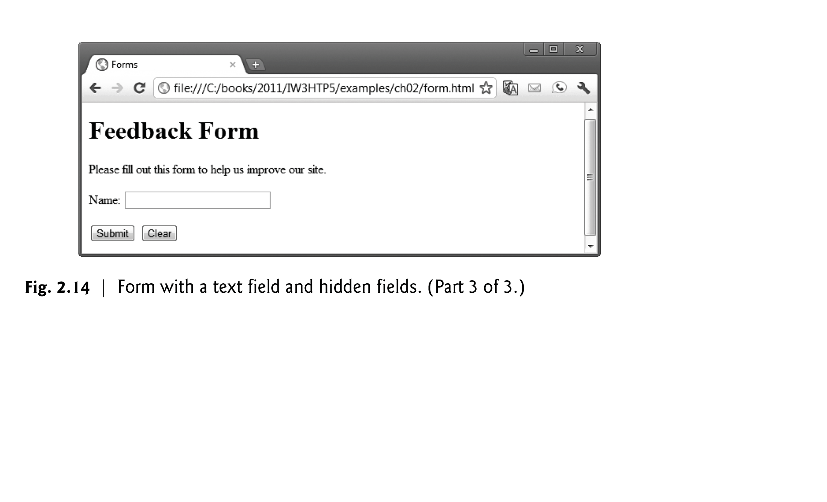
EXAMPLE-Output

Slide 61
2.11 Forms (Cont.)
method Attribute of the form Element
A form is defined by a form element
Attribute method specifies how the form’s data is sent to the web server.
Using method = "post" appends form data to the browser request, which contains the protocol (HTTP) and the requested resource’s URL.
The other possible value, method = "get", appends the form data directly to the end of the URL of the script, where it’s visible in the browser’s Address field.
The action attribute of the form element specifies the script to which the form data will be sent
61
Notes:
61

Slide 62
2.11 Forms (Cont.)
action Attribute of the form Element
The action attribute of the form element specifies the script to which the form data will be sent.
Since we haven’t introduced server-side programming yet, we set this attribute to http://www.deitel.com for now.
input elements that specify data to provide to the script that processes the form (also called the form handler).
An input’s type is determined by its type attribute.
62
Notes:
62

Slide 63
2.11 Forms (Cont.)
Hidden Inputs
Forms can contain visual and nonvisual components.
Visual components include clickable buttons and other graphical user interface components with which users interact.
Nonvisual components, called hidden inputs, store any data that you specify, such as e-mail addresses and HTML5 document file names that act as links.
63
Notes:
63

Slide 64
2.11 Forms (Cont.)
text input Element
The text input inserts a text field into the form, which allows the user to input data.
The label element provides users with information about the input element’s purpose
The size attribute specifies the number of characters visible in the text field.
Optional attribute maxlength limits the number of characters input into a text field.
64
Notes:
64

Slide 65
2.11 Forms (Cont.)
submit and reset input Elements
The submit input element is a button.
When the submit button is pressed, the form’s data is sent to the location specified in the form’s action attribute.
The value attribute sets the text displayed on the button.
The reset input element allows a user to reset all form elements to their default values.
65
Notes:
65

Slide 66
2.11 Forms (Cont.)
Additional Form Elements
Figure 2.15 contains a form that solicits user feedback about a website.
The textarea element inserts a multiline text area into the form.
The number of rows is specified with the rows attribute, and the number of columns (i.e., characters per line) with the cols attribute.
Default text can be specified in other input types, such as text fields, by using the value attribute.
66
Notes:
66

Slide 67
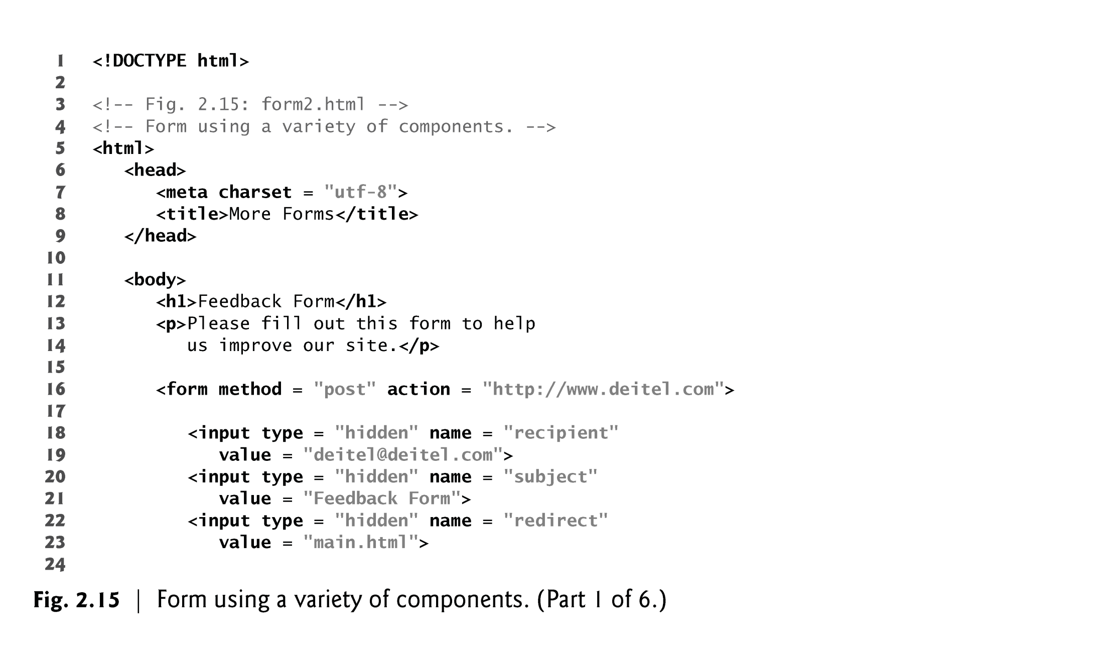
Difference between GET and POST method in HTTP Protocol
1) GET method passes request parameter in URL String while POST method passes request parameter in request body.
2) GET request can only pass limited amount of data while POST method can pass large amount of data to server.
3) GET request can be bookmarked and cached unlike POST requests.
4) GET is mostly used for view purpose (e.g. SQL SELECT) while POST is mainly use for update purpose (e.g. SQL INSERT or UPDATE).
EXAMPLE

Slide 68
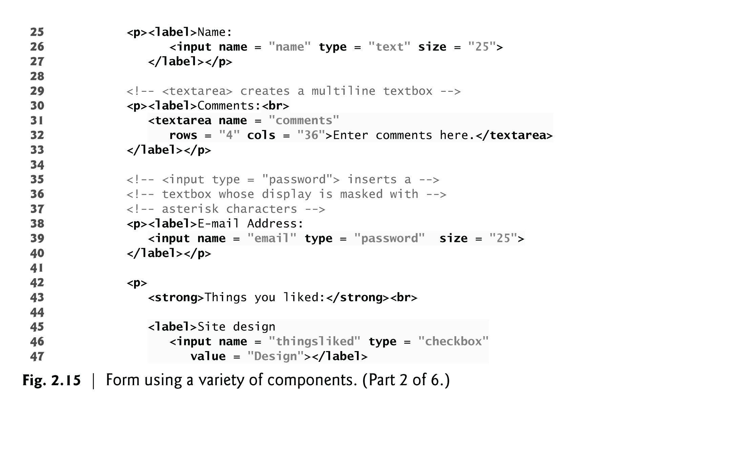
EXAMPLE (Cont…)

Slide 69
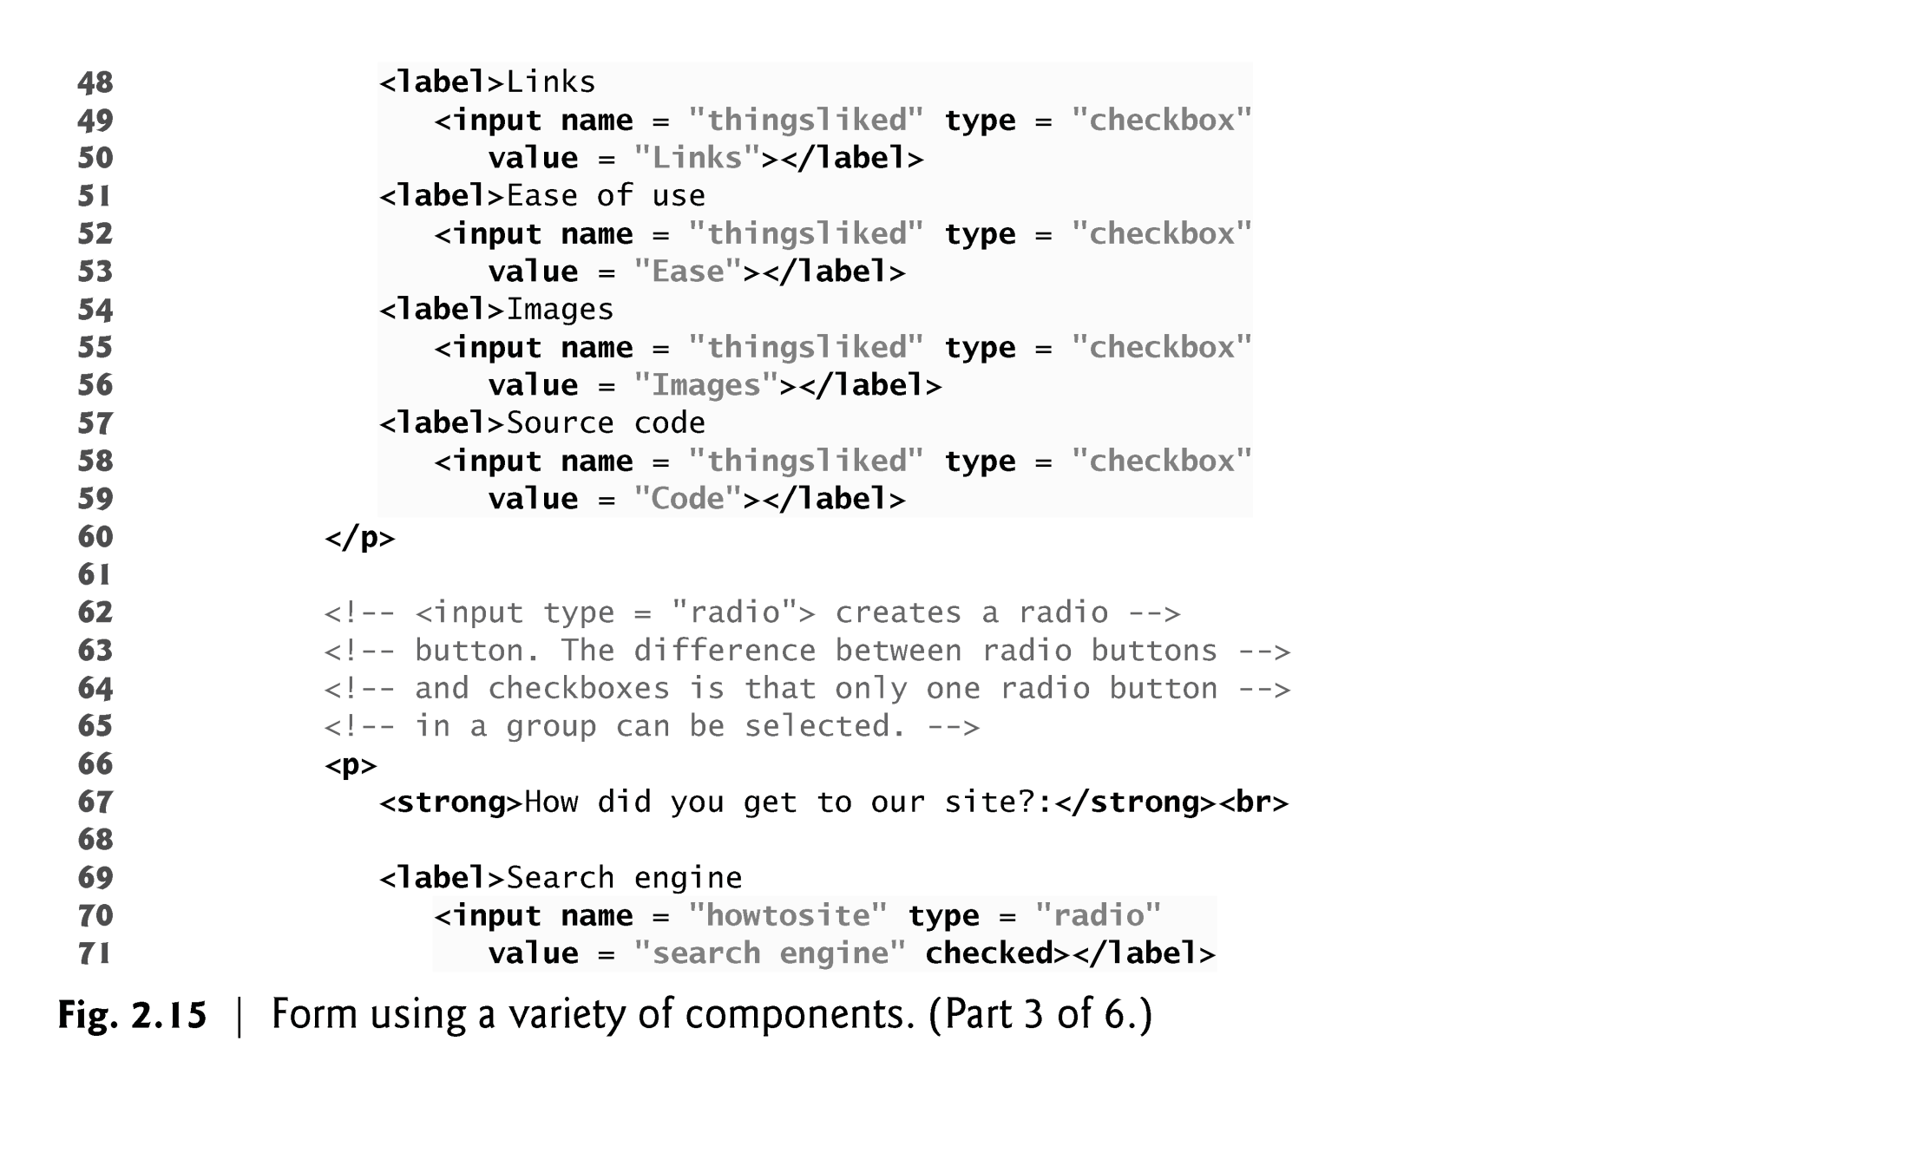
EXAMPLE (Cont…)

Slide 70
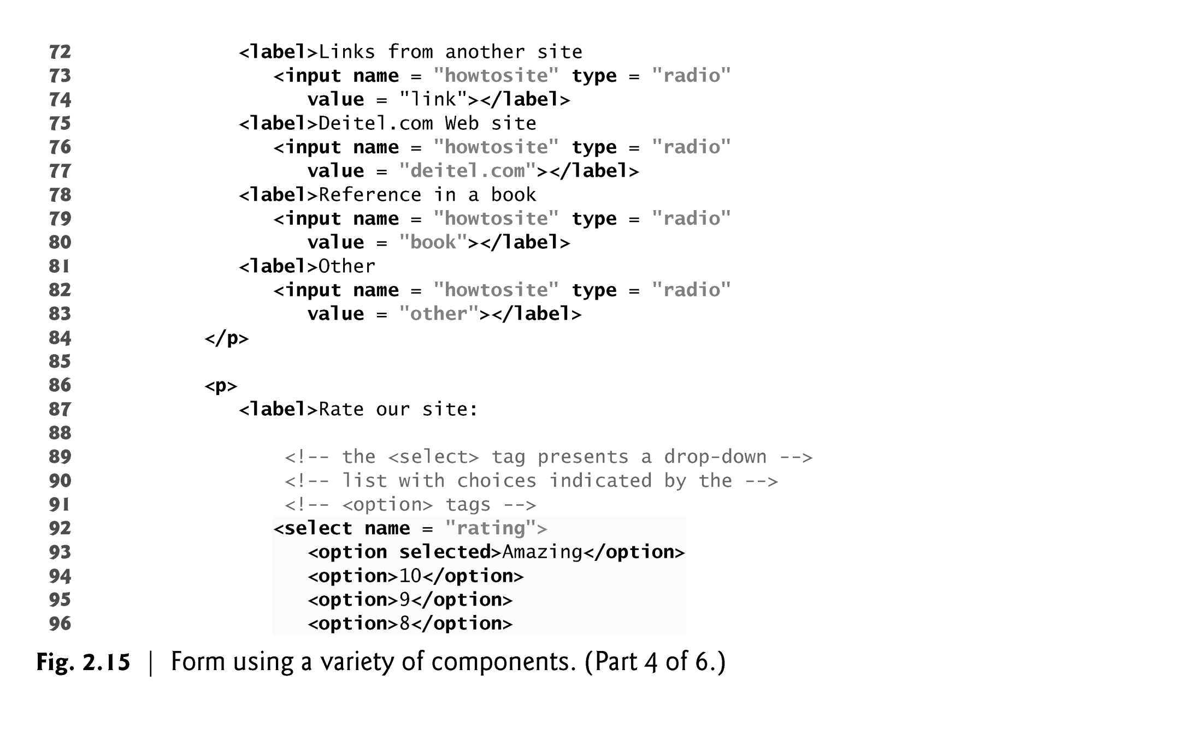
EXAMPLE (Cont…)

Slide 71
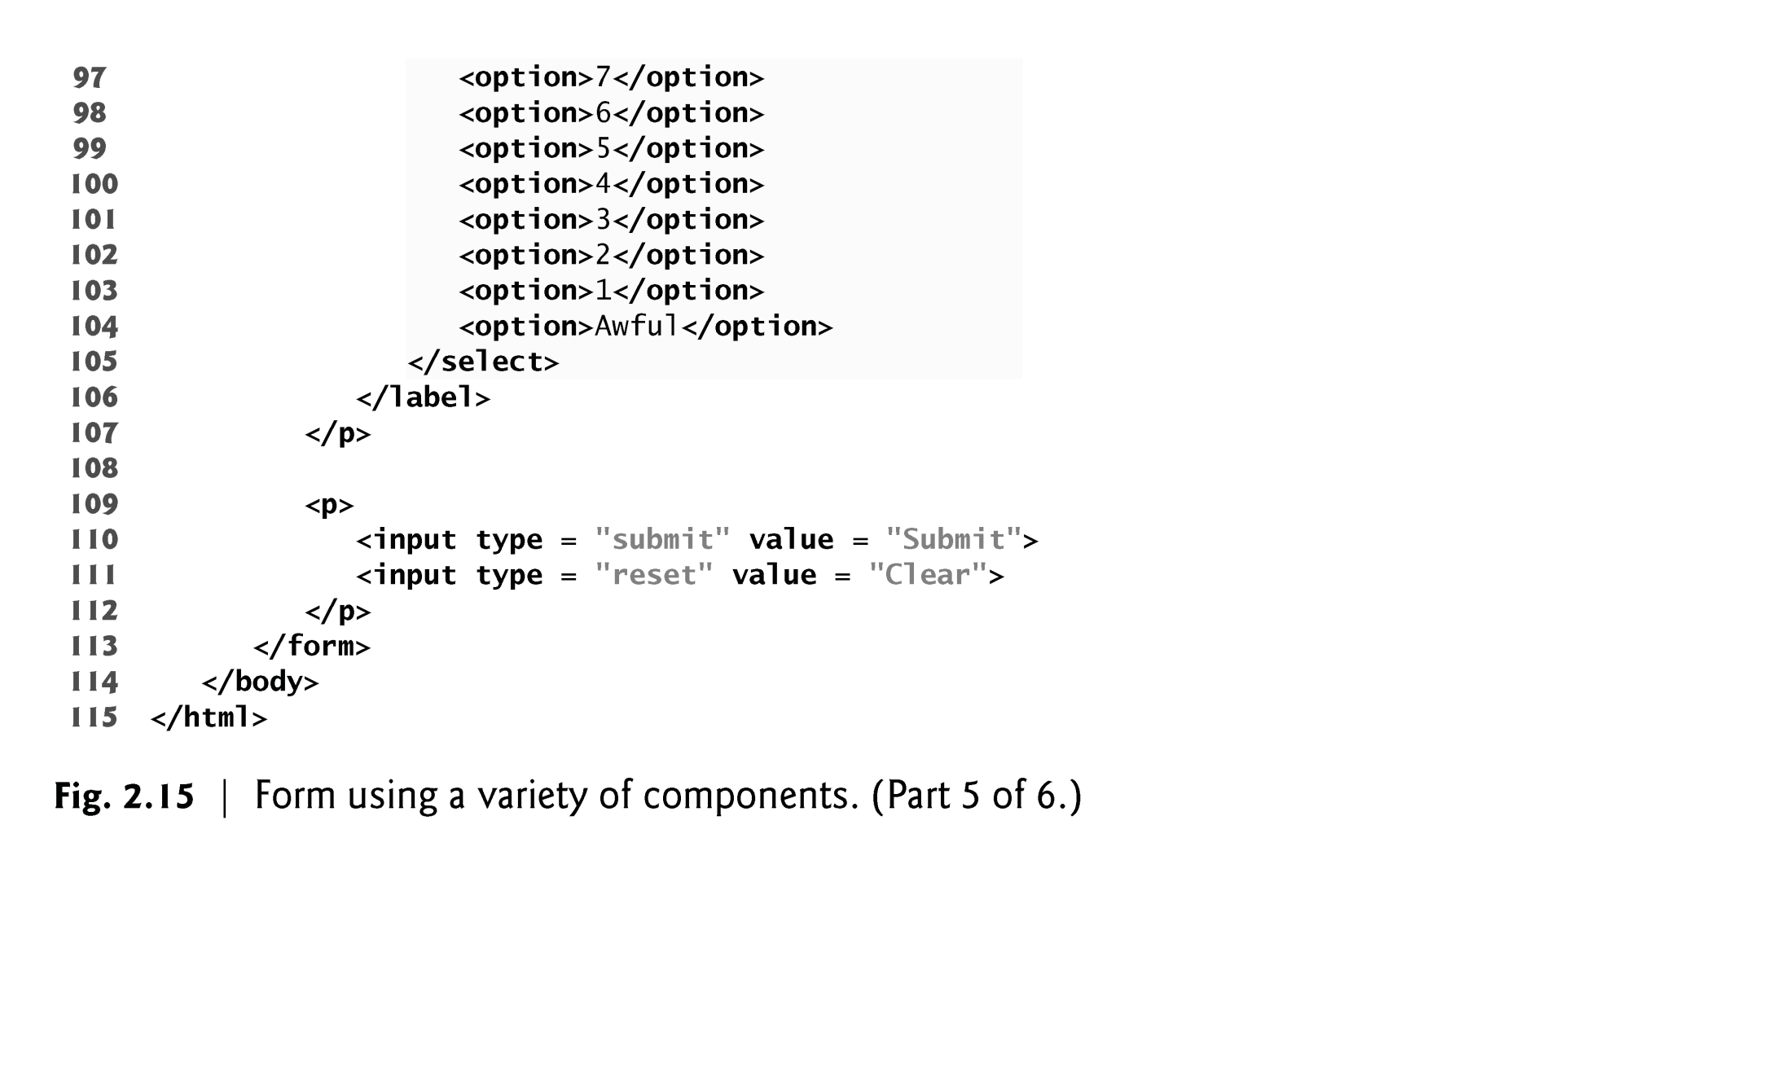
EXAMPLE (Cont…)

Slide 72
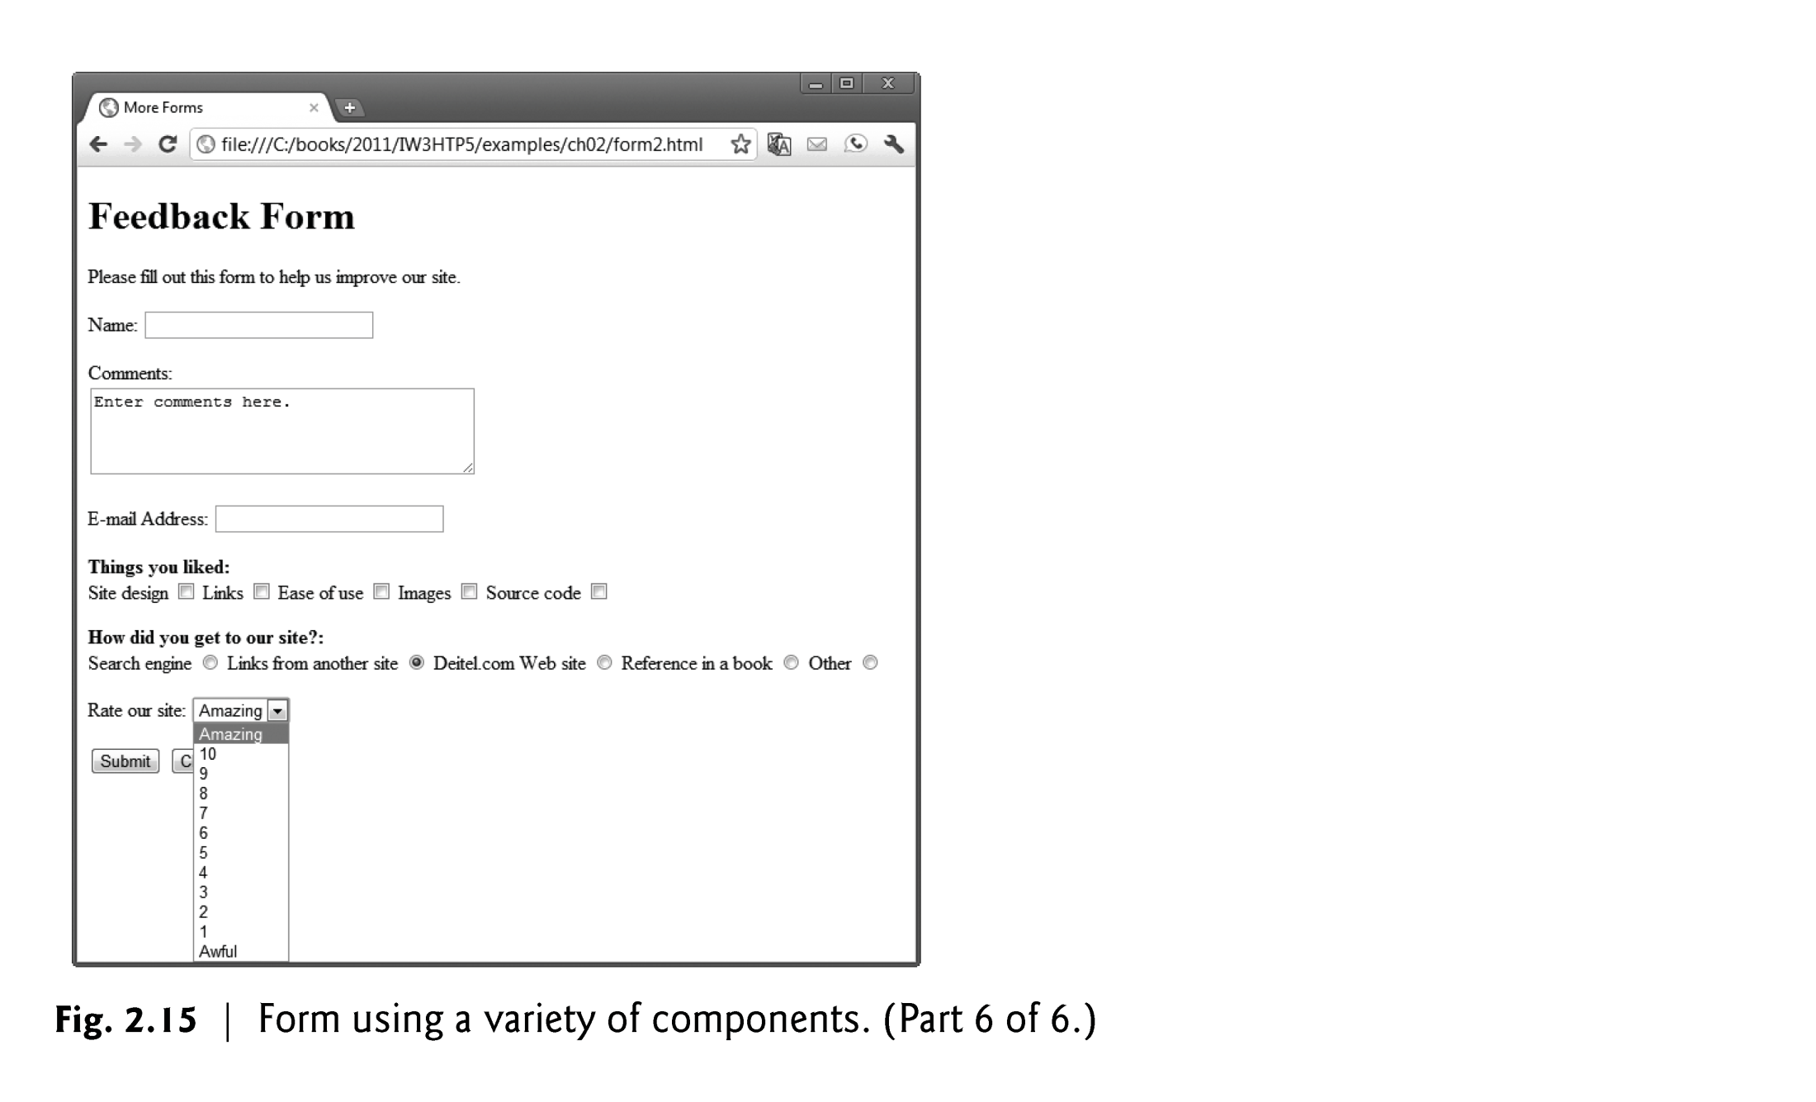
EXAMPLE-Output

Slide 73
2.11 Forms (Cont.)
The password input inserts a password box into a form.
Allows users to enter sensitive information, such as credit card numbers and passwords, by “masking” the information input with another character, usually asterisks.
The actual value input is sent to the web server, not the asterisks that mask the input.
73
Notes:
73

Slide 74
2.11 Forms (Cont.)
The checkbox input element enables users to select and option.
When the checkbox is selected, a check mark appears in the checkbox . Otherwise, the checkbox is empty
checkboxes can be used individually and in groups. checkboxes that are part of the same group have the same name
radio buttons are similar to checkboxes, except that only one radio button in a group can be selected at any time.
All radio buttons in a group have the same name attribute but different value attributes.
The select input provides a drop-down list of items.
The name attribute identifies the drop-down list.
The option element adds items to the drop-down list.
74
Notes:
74

Slide 75
2.12 Internal Linking
The a tag can be used to link to another section of the same document by specifying the element’s id as the link’s href.
To link internally to an element with its id attribute set, use the syntax #id.
75
Notes:
75

Slide 76
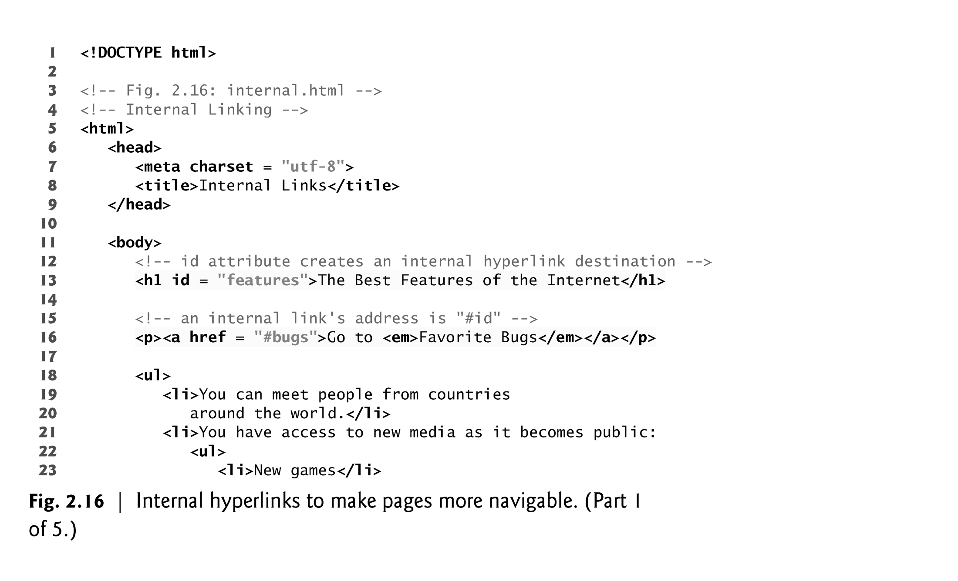
EXAMPLE

Slide 77
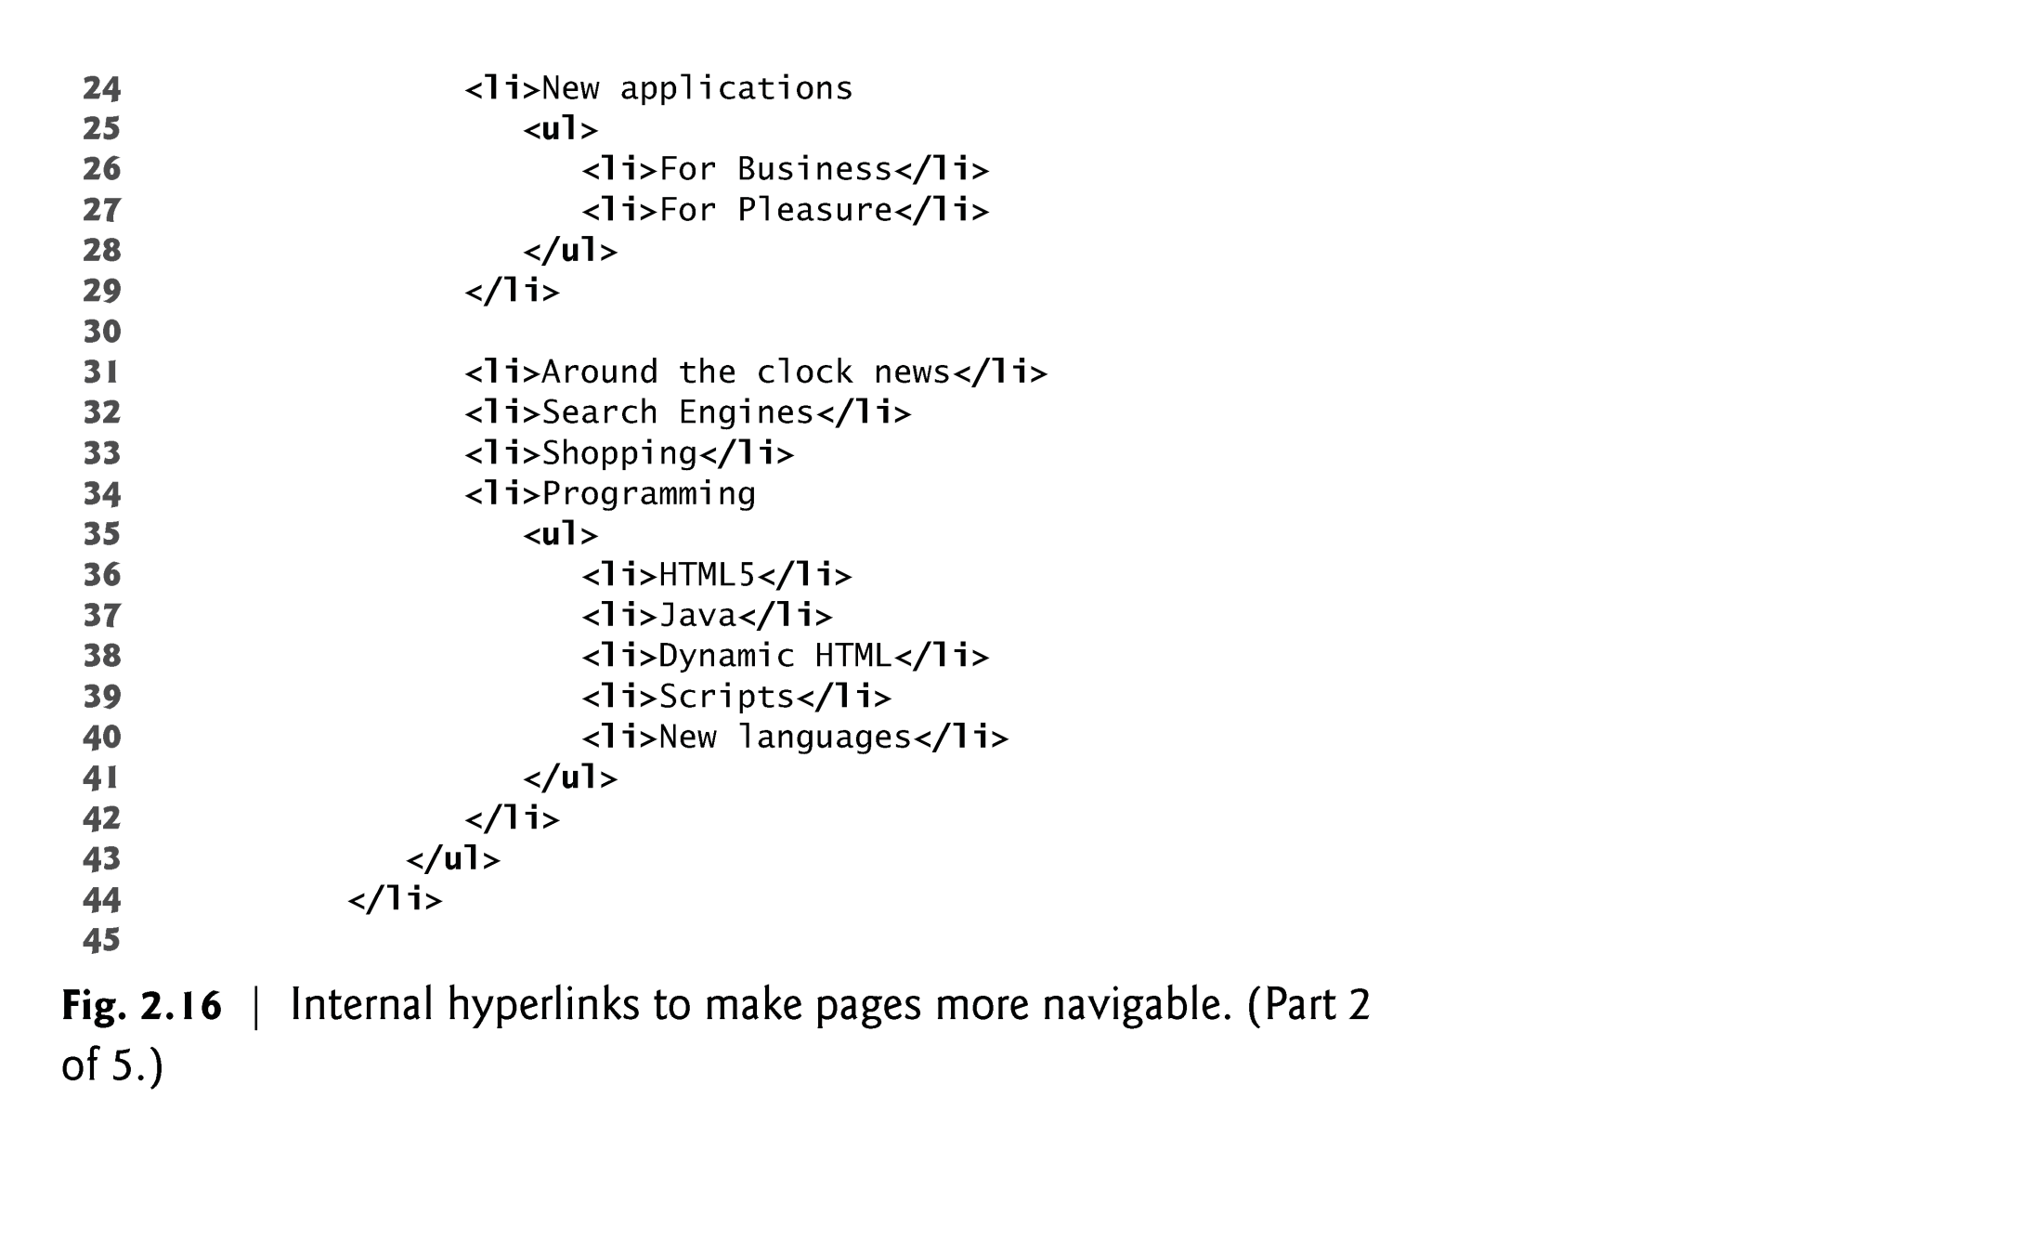
EXAMPLE

Slide 78
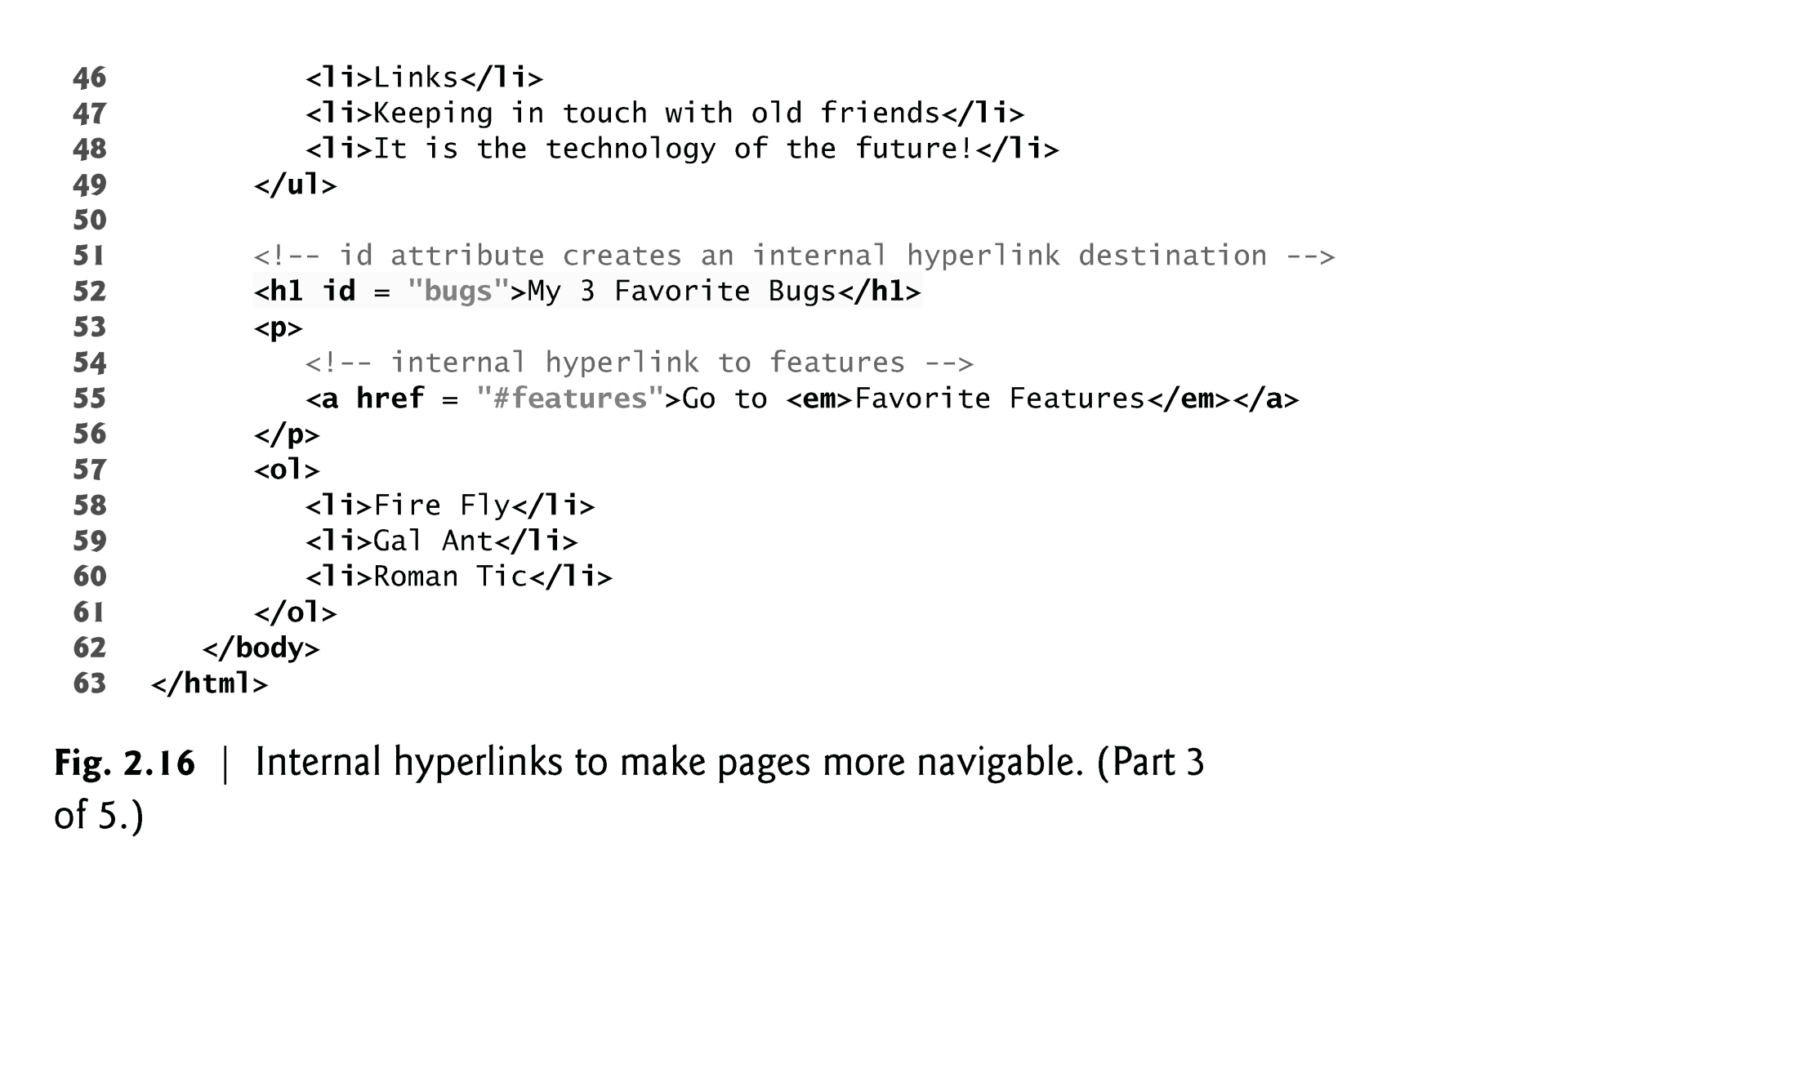
EXAMPLE (Cont…)

Slide 79
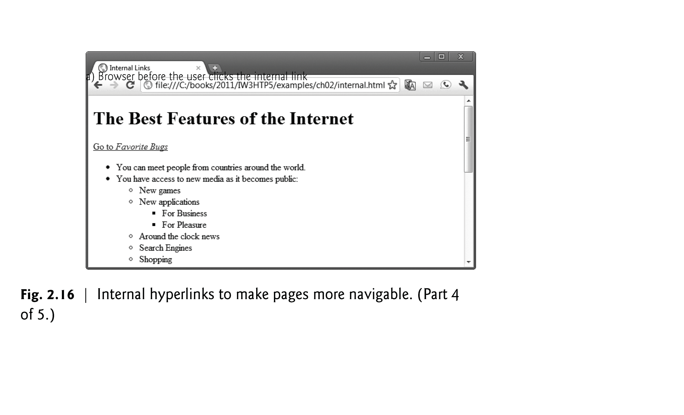
EXAMPLE- Output

Slide 80
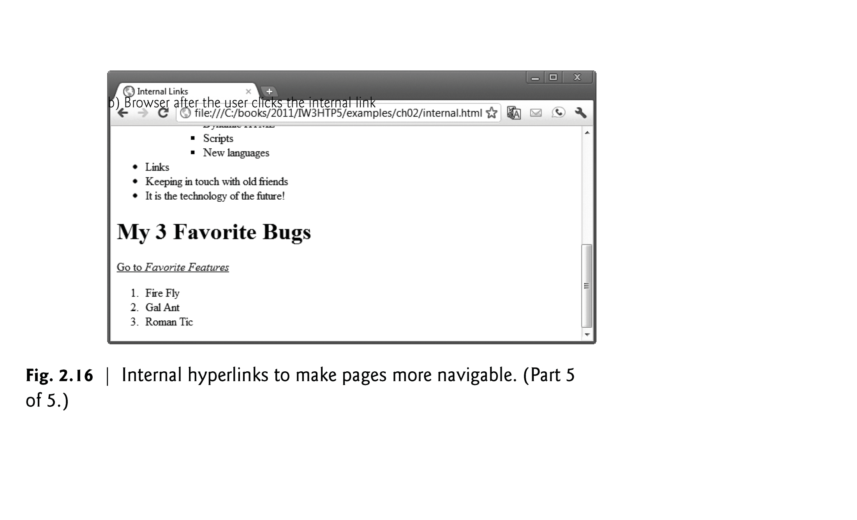
EXAMPLE-Output

Slide 81
2.13 meta Elements
One way that search engines catalog pages is by reading the meta element’s contents.
The name attribute identifies the type of meta element
The content attribute
Of a keywords meta element: provides search engines with a list of words that describe a page, which are compared with words in search requests
Of a description meta element: provides a three- to four-line description of a site in sentence form, used by search engines to catalog your site. This text is sometimes displayed as part of the search result
81
Notes:
81

Slide 82
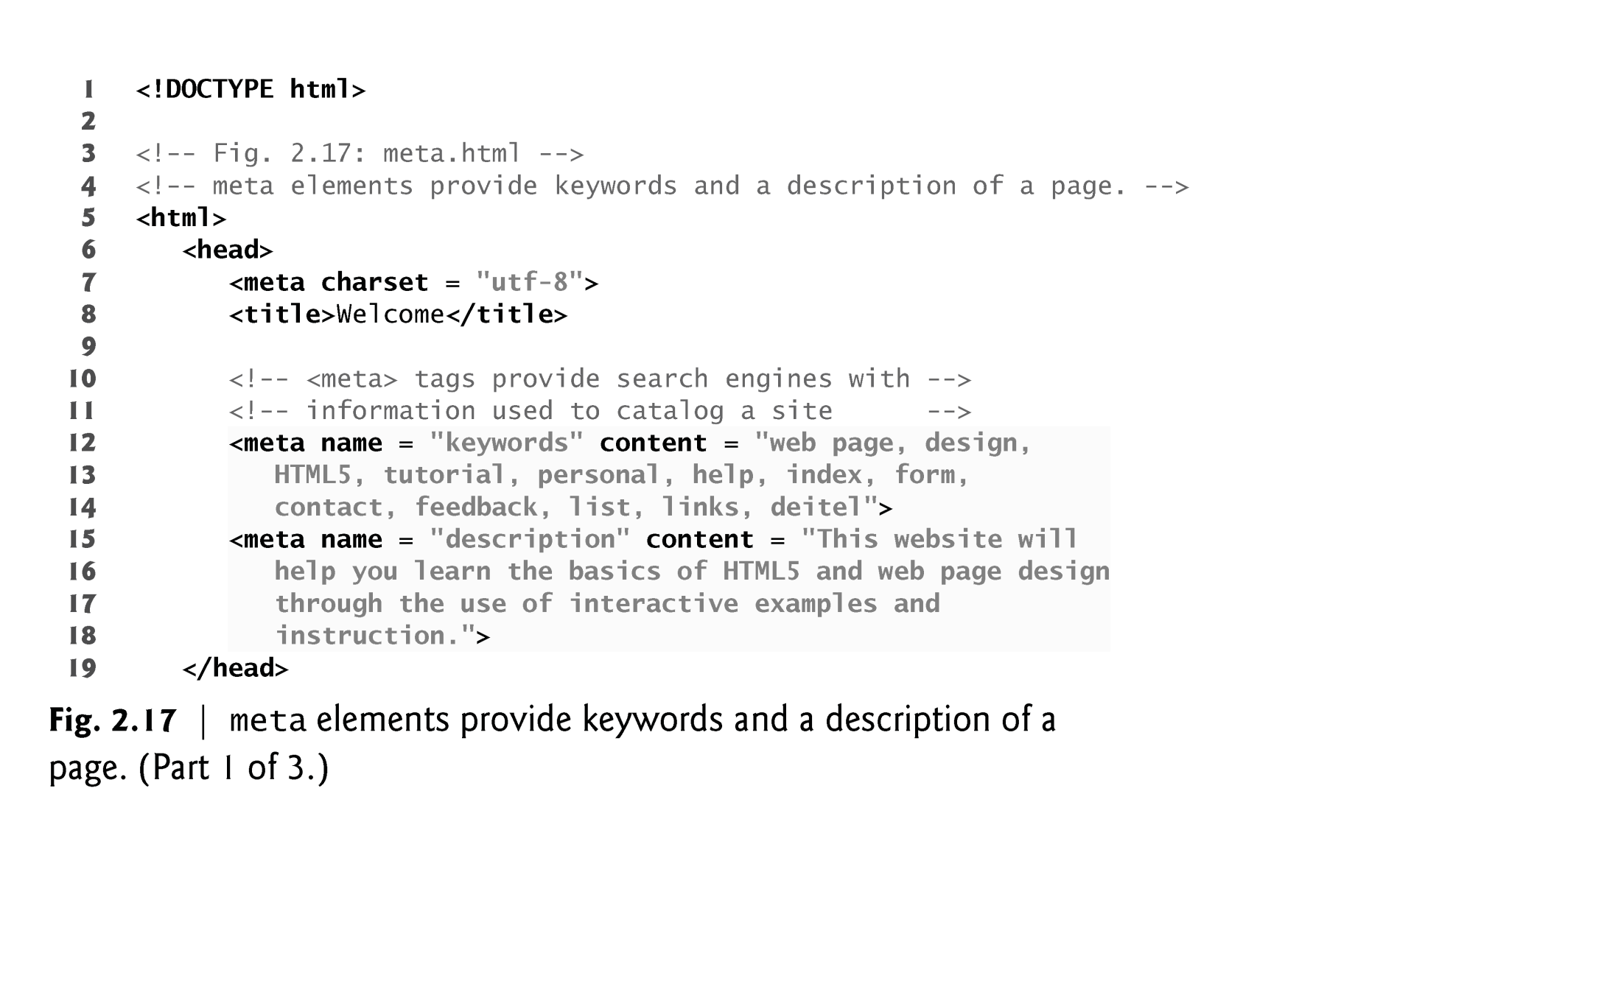
EXAMPLE

Slide 83
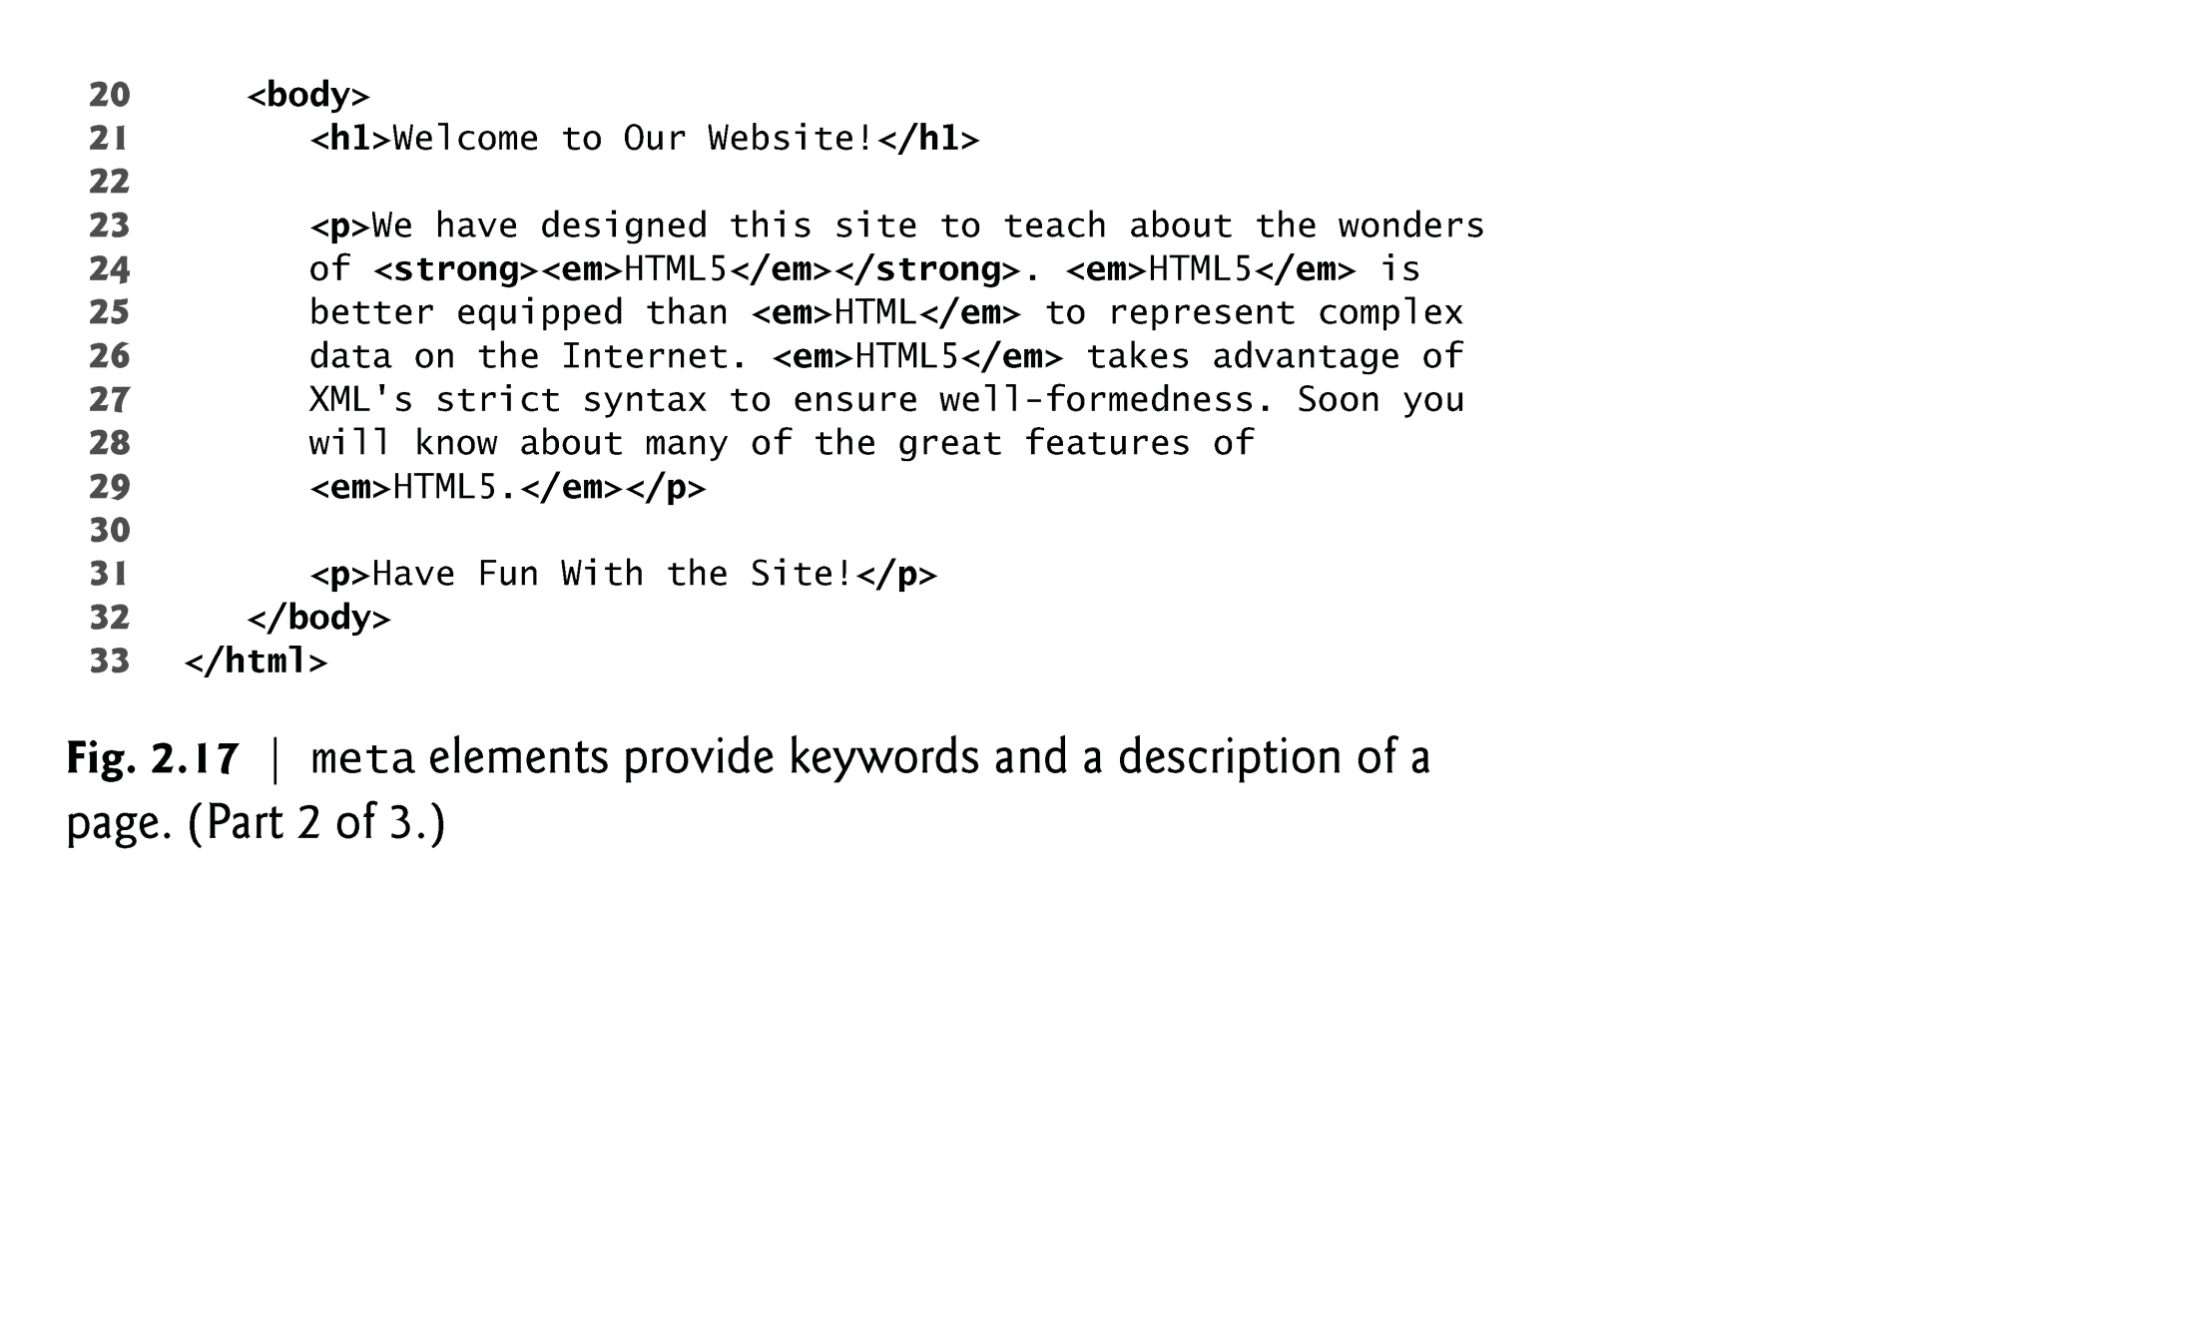
EXAMPLE (Cont…)

Slide 84
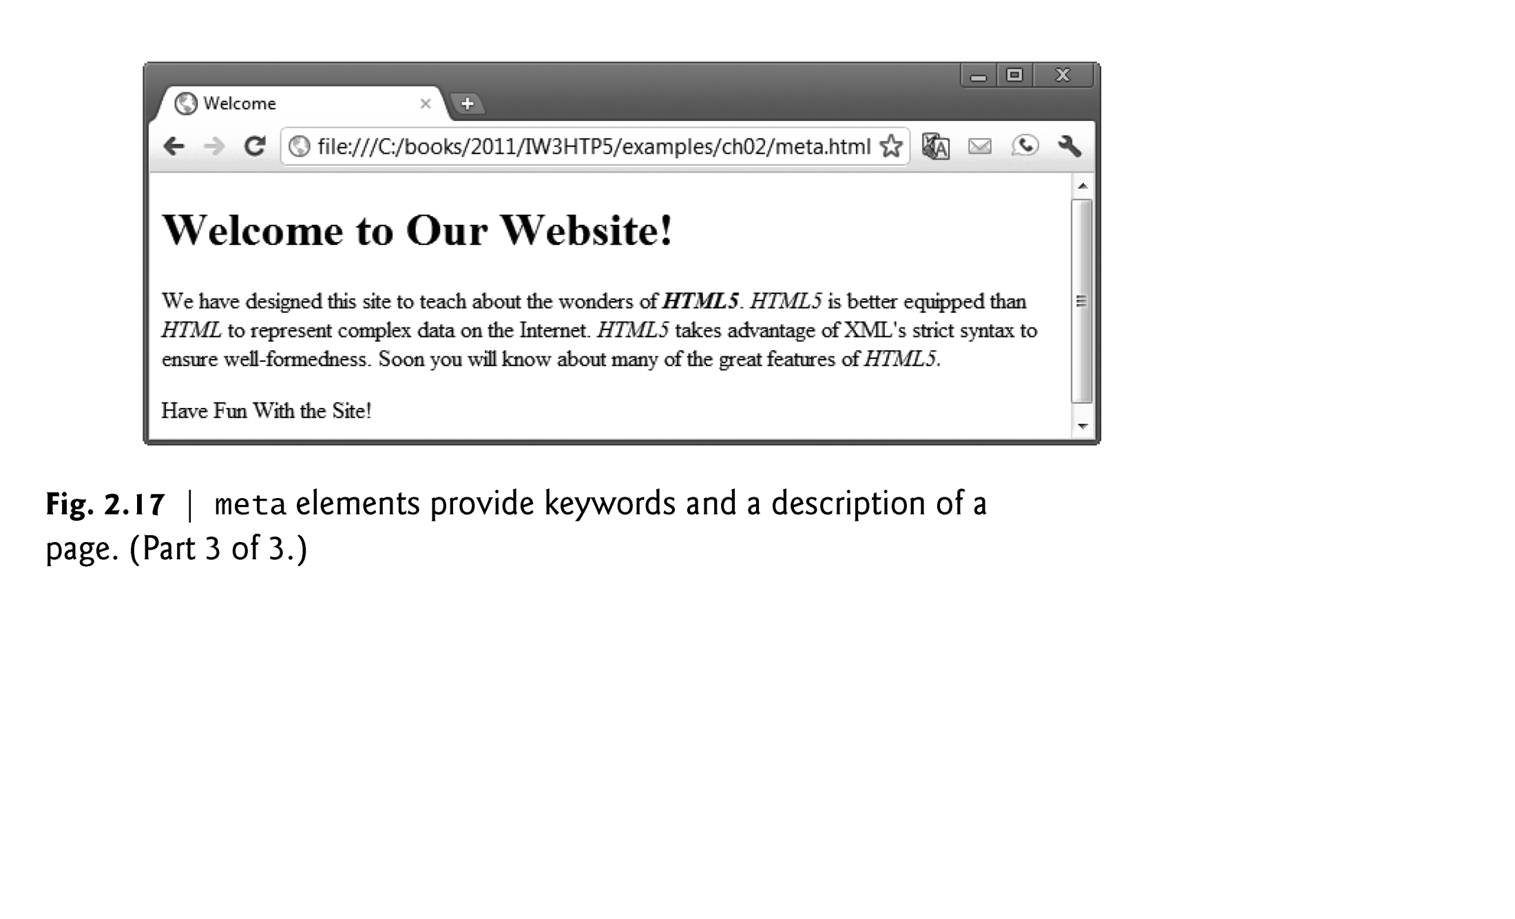
EXAMPLE (Cont…)

Slide 85
More element in HTML5
Tag | Description
<article> | Defines an article in a document
<aside> | Defines content aside from the page content
<bdi> | Isolates a part of text that might be formatted in a different direction from other text outside it
<details> | Defines additional details that the user can view or hide
<dialog> | Defines a dialog box or window
<figcaption> | Defines a caption for a <figure> element
<figure> | Defines self-contained content
<footer> | Defines a footer for a document or section
<header> | Defines a header for a document or section
<main> | Defines the main content of a document
<mark> | Defines marked/highlighted text
<menuitem> | Defines a command/menu item that the user can invoke from a popup menu
<meter> | Defines a scalar measurement within a known range (a gauge)
<nav> | Defines navigation links
<progress> | Represents the progress of a task
<rp> | Defines what to show in browsers that do not support ruby annotations
<rt> | Defines an explanation/pronunciation of characters (for East Asian typography)
<ruby> | Defines a ruby annotation (for East Asian typography)
<section> | Defines a section in a document
<summary> | Defines a visible heading for a <details> element
<time> | Defines a date/time
<wbr> | Defines a possible line-break

